Slide 1
Unemployment Insurance
Access this PowerPoint presentation online at https://esd.wa.gov/newsroom/introduction-to-unemployment-insurance-public-webinar

Slide 2
Topics we will cover
Reemployment Services that are available
How to file an unemployment insurance initial claim
For covered employment, for self employed, for independent contractors, and for those with limited employment
This includes regular unemployment and PUA
The presentation will answer most questions
Accessing this PowerPoint presentation online at https://esd.wa.gov/newsroom/introduction-to-unemployment-insurance-public-webinar

Slide 3
Topics we will NOT cover
Reasons why you are denied
Specific questions related to your situation
How to appeal
Fixing a claim
Accessing this PowerPoint presentation online at https://esd.wa.gov/newsroom/introduction-to-unemployment-insurance-public-webinar

Slide 4
What you will need
Logged in and on the Internet, www.esd.wa.gov
Pen and paper
SSN, address, Date of birth
Employer names, addresses, and dates of employment for past 18 months
Bank routing and account numbers – if you want to sign up for direct deposit today

Slide 5
What we know about the Stimulus Bill
Pandemic Unemployment Assistance
This will expand benefits to those that are generally not covered by regular unemployment, such as self employed, independent contractors, worked less that 680 hours
An additional $600 added to benefits each week, Mar 29-Jul 25
Pandemic Emergency Unemployment Compensation
An additional 13 weeks for those that have exhausted their benefits
All benefits will be retroactive back to the effective date given by DOL based on individual eligibility
Follow www.esd.wa.gov for the latest information. You can even sign up to get alerts when new information is posted.
This Photo by Unknown Author is licensed under CC BY-SA

Slide 6
Reemployment Services
Being laid off can be painful
WorkSource is here to help
Thousands of jobs on WorkSourceWA.com
Veteran services
Retraining services

Slide 7
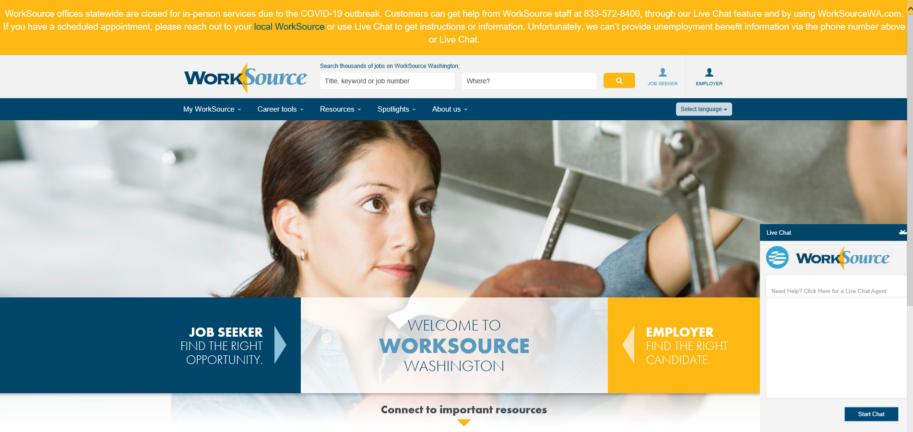
WorkSourceWA.com

Slide 8
Filing an Unemployment Insurance Claim

Slide 9
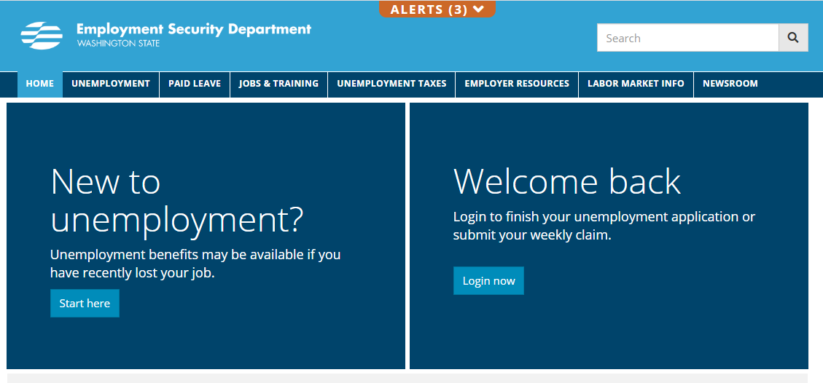
ESD.WA.GOV

Slide 10
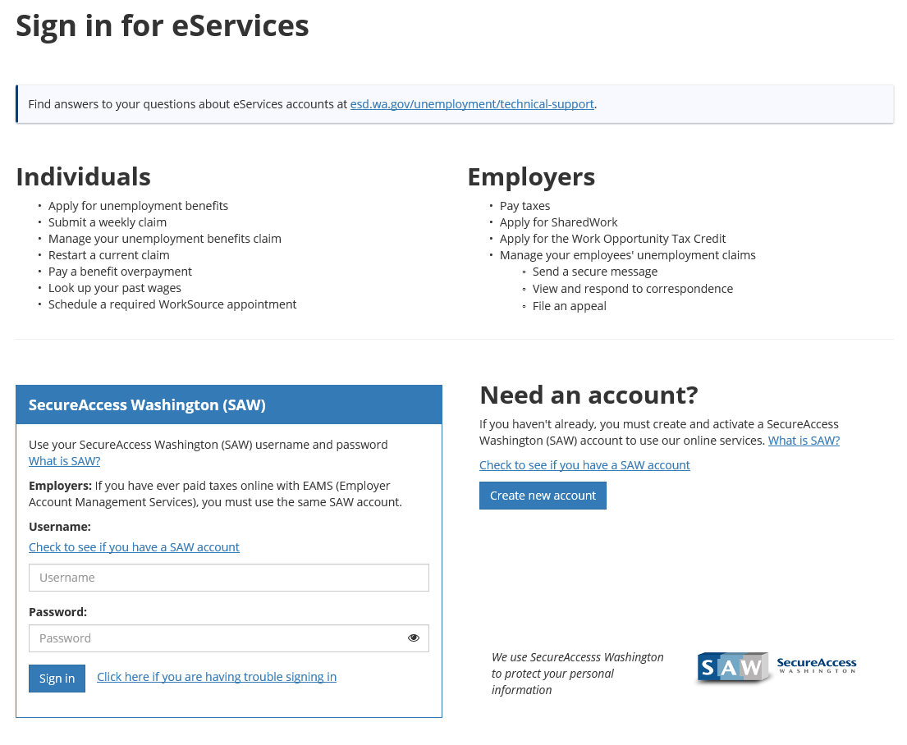

Slide 11
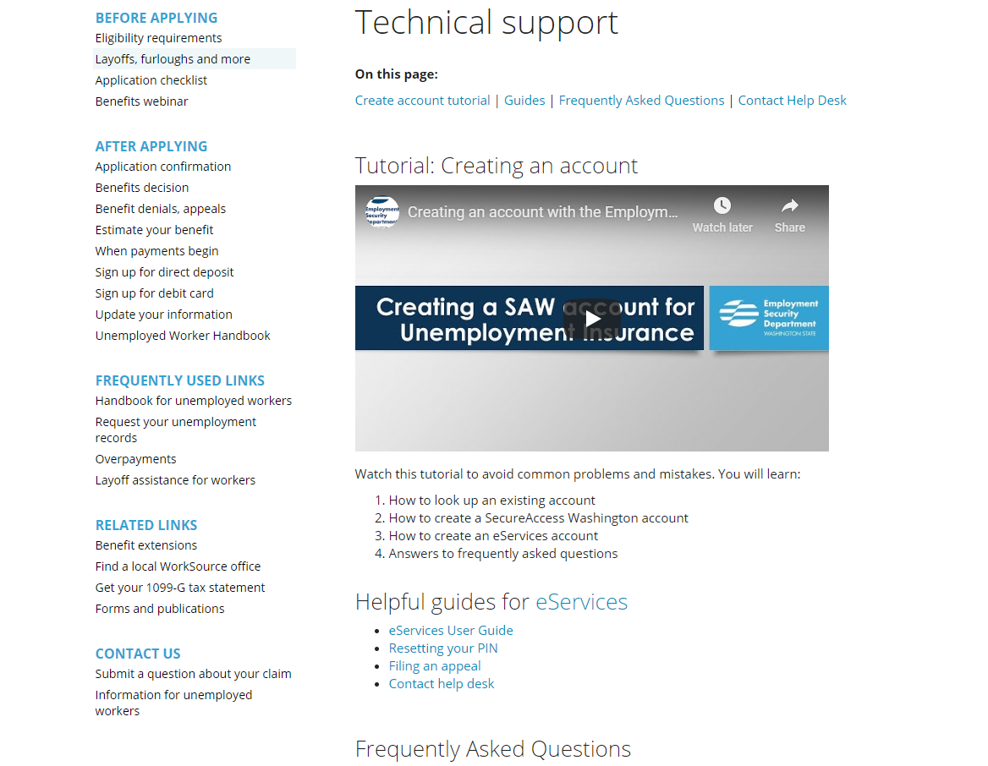

Slide 12
Type your Username and Password and click Sign in

Slide 13
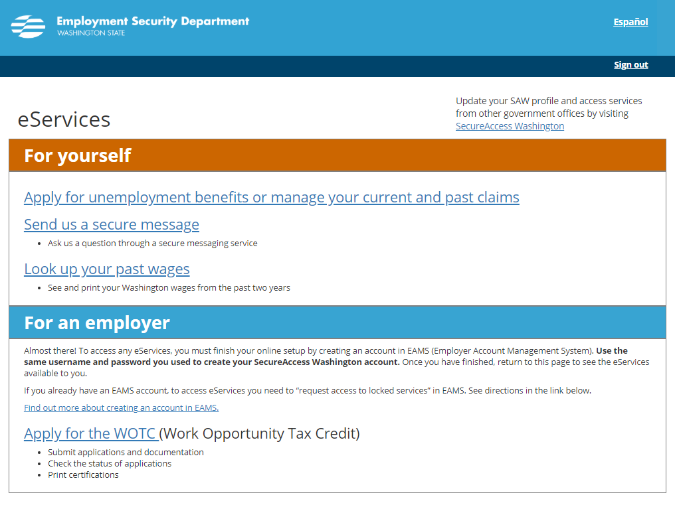

Slide 14
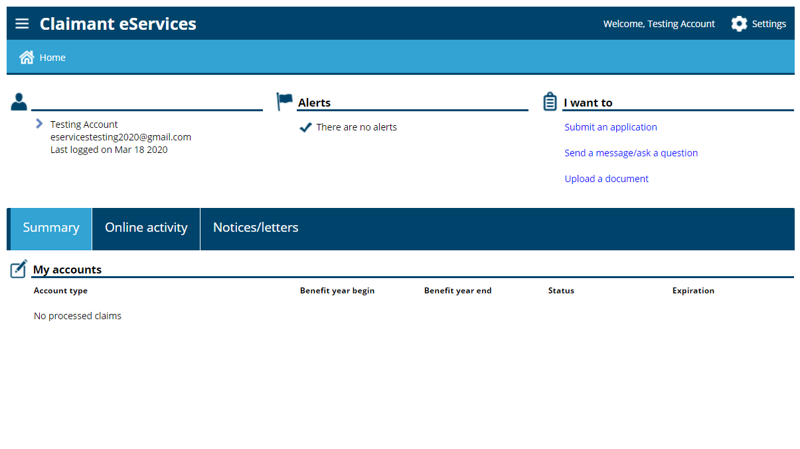

Slide 15
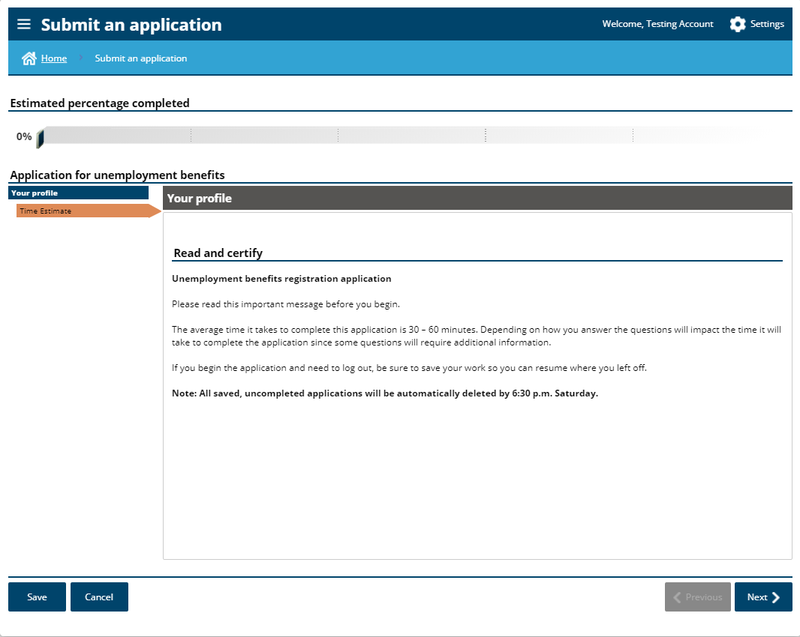

Slide 16
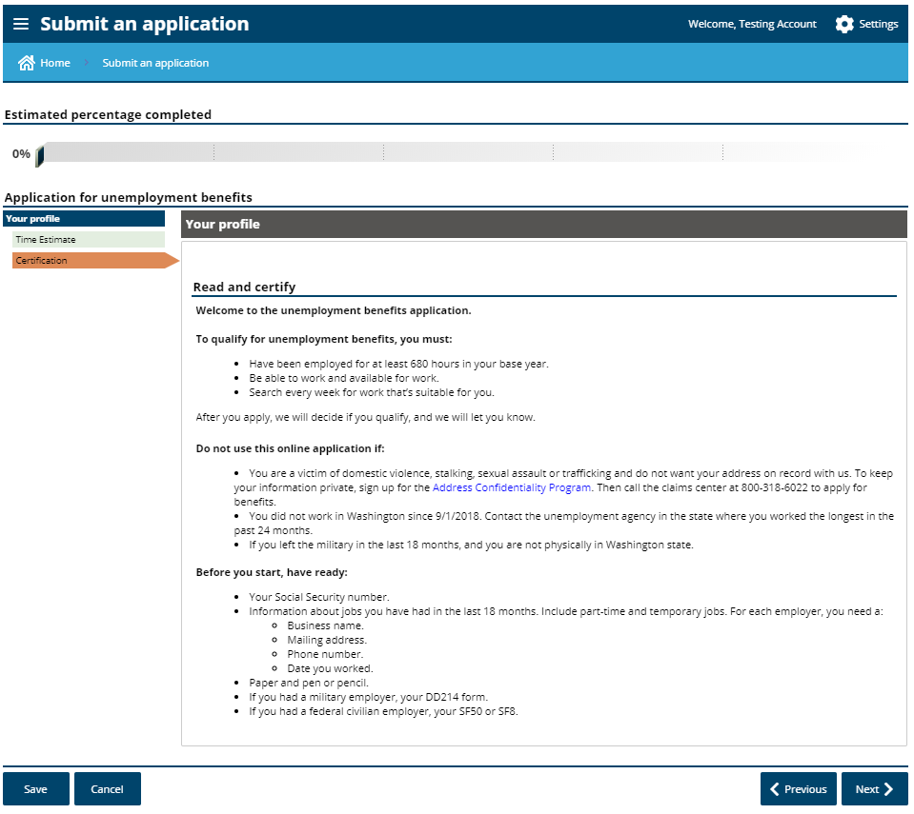

Slide 17
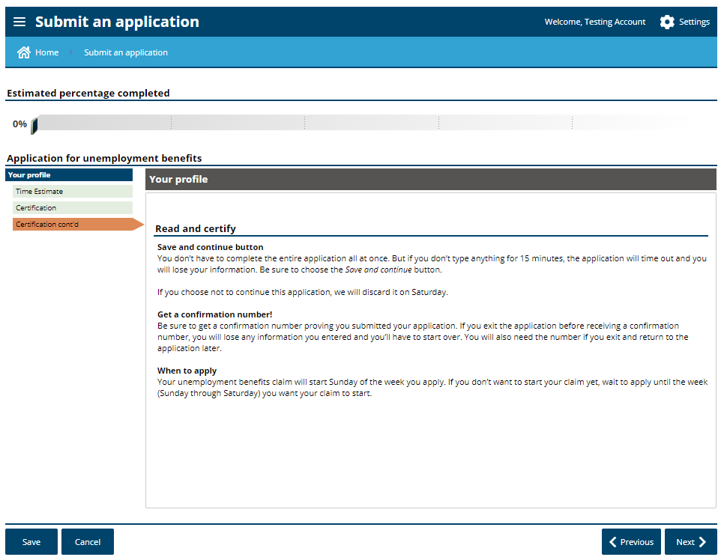

Slide 18
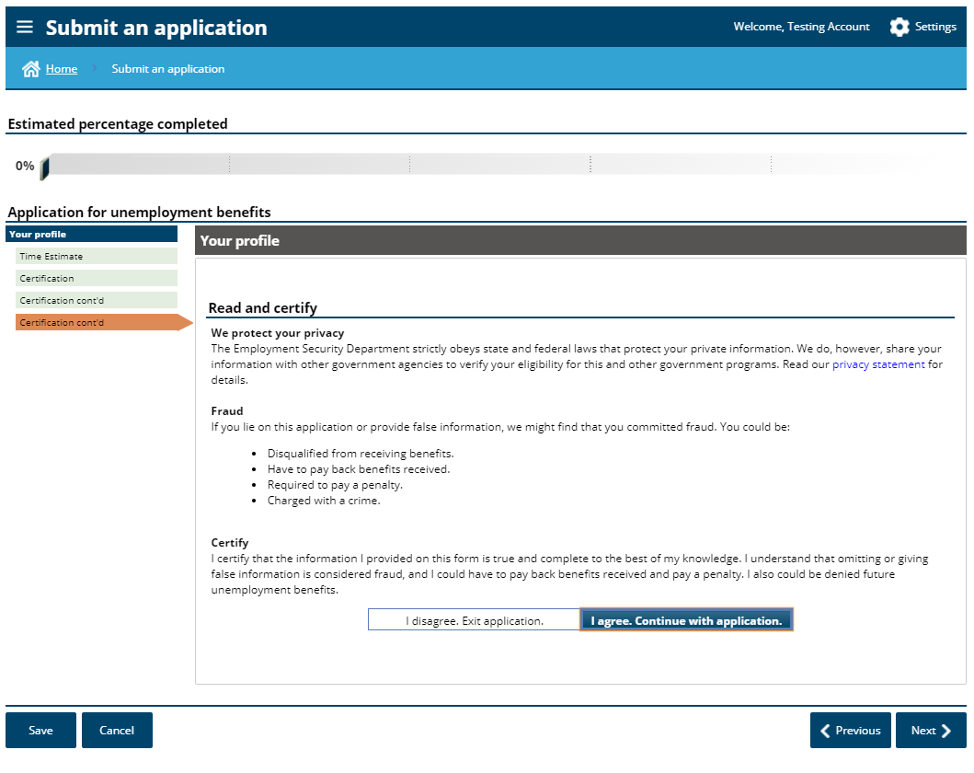

Slide 19
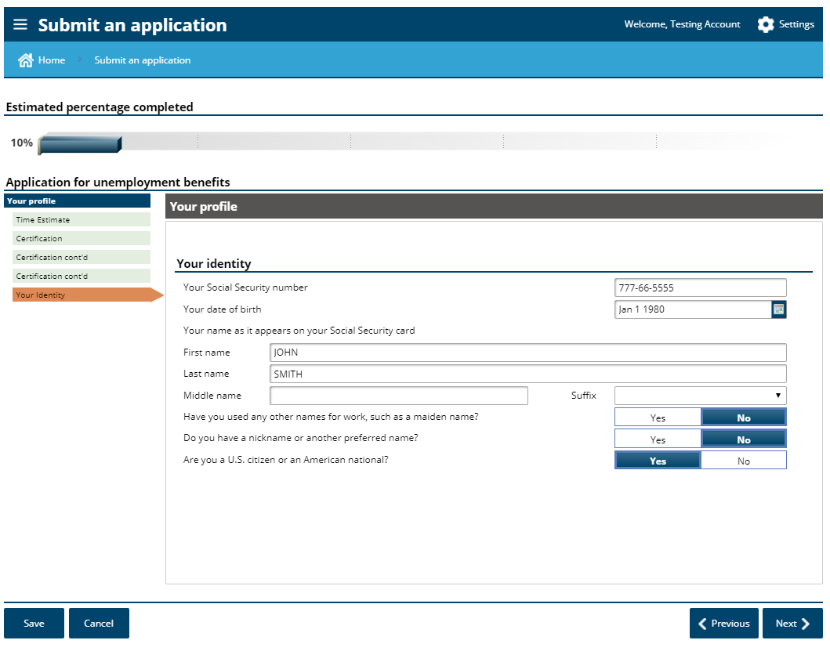

Slide 20
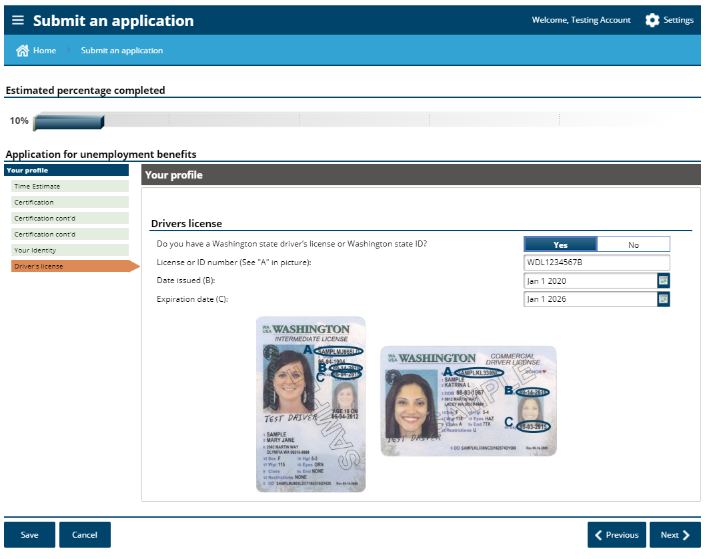

Slide 22
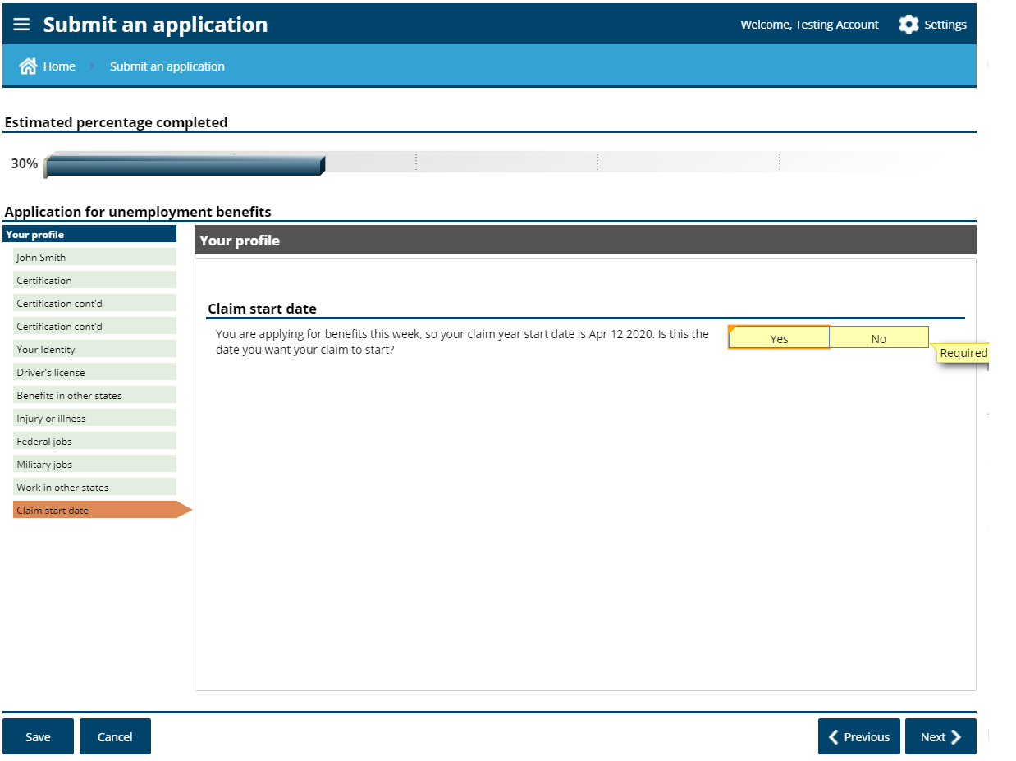

Slide 23
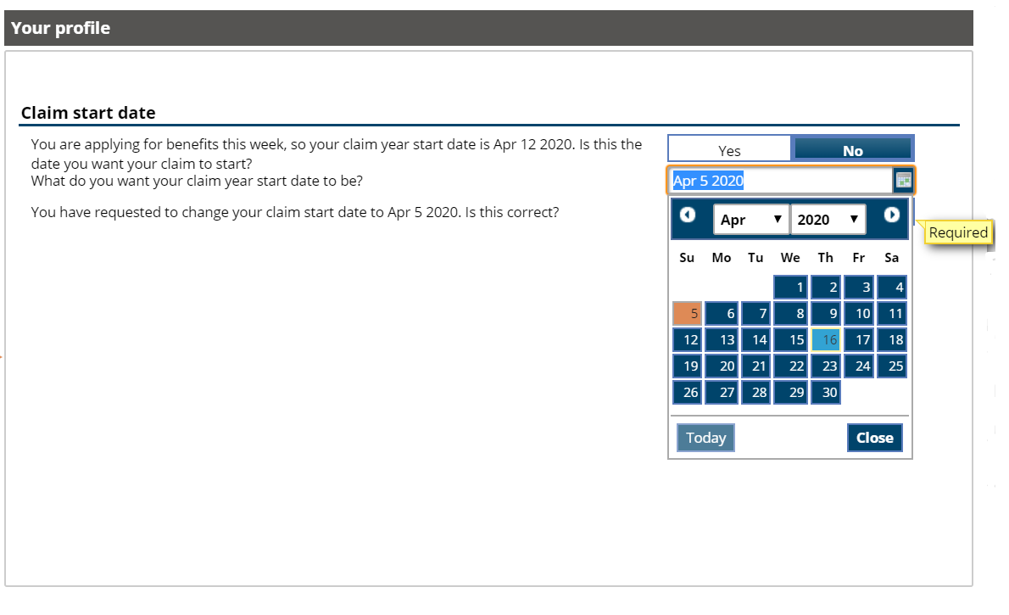
Claim start date should be determined by your last paid day and when you want to start claiming.
For self employed – select the date that you were no longer working or earning income.

Slide 24
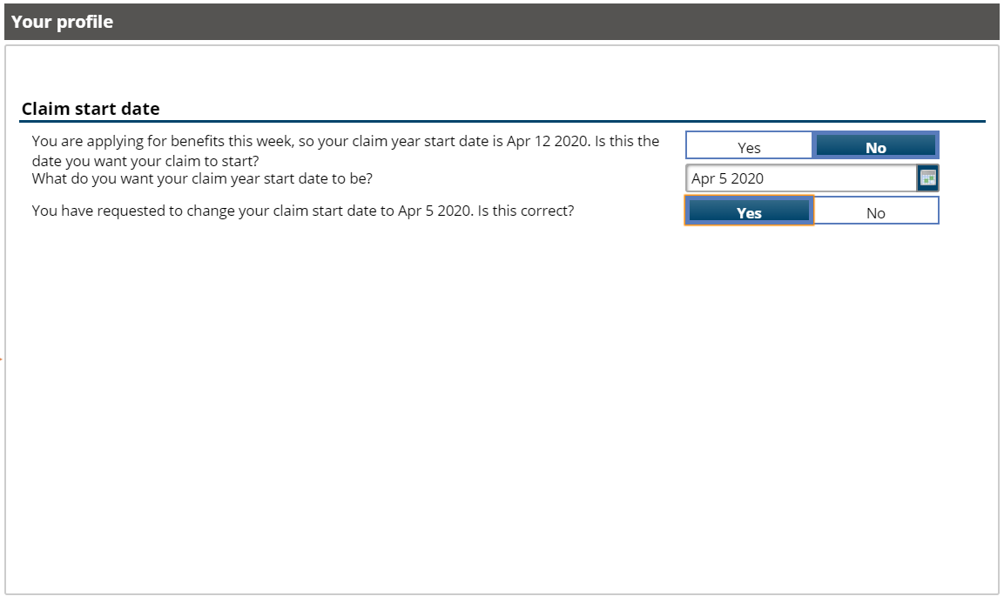

Slide 25
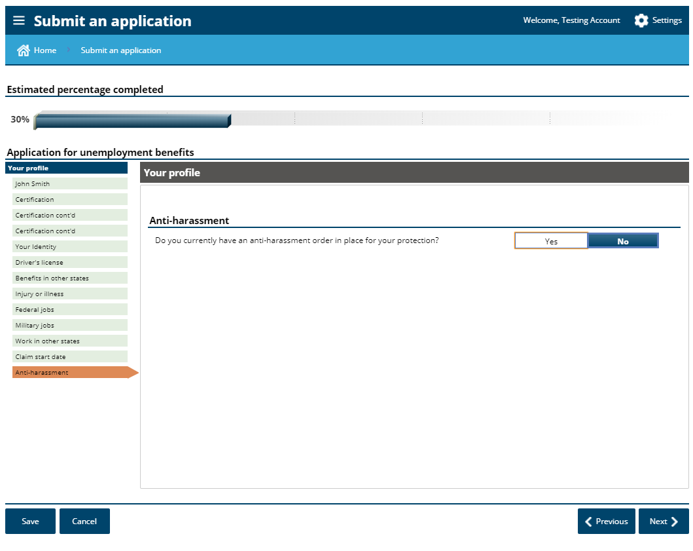

Slide 26
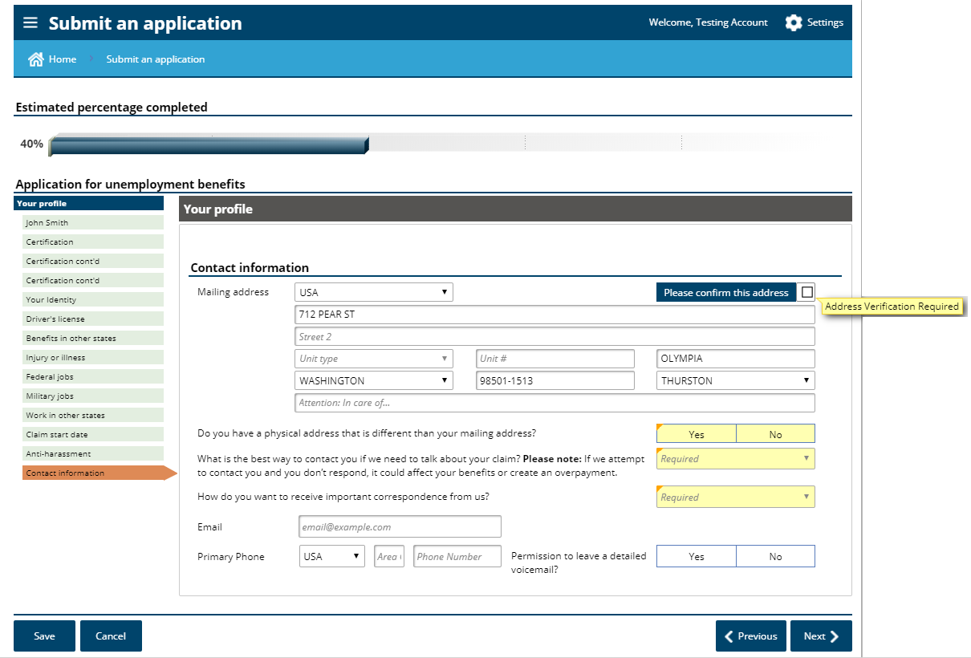

Slide 27
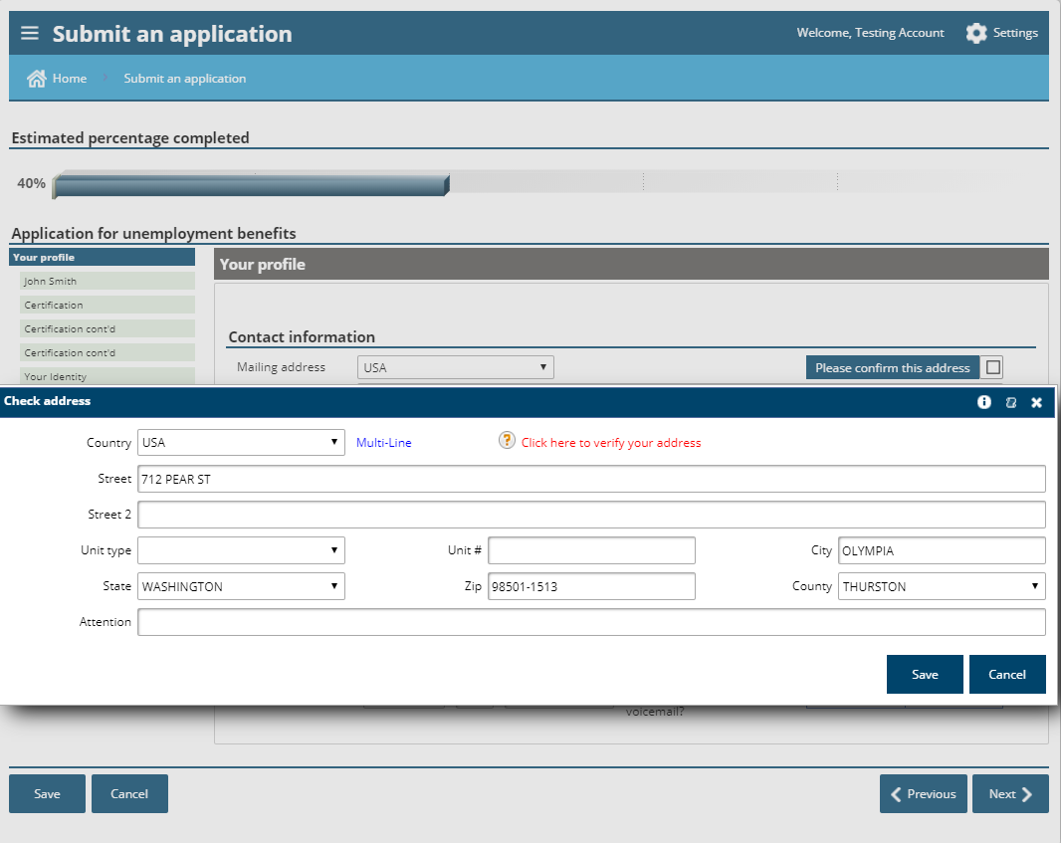

Slide 28
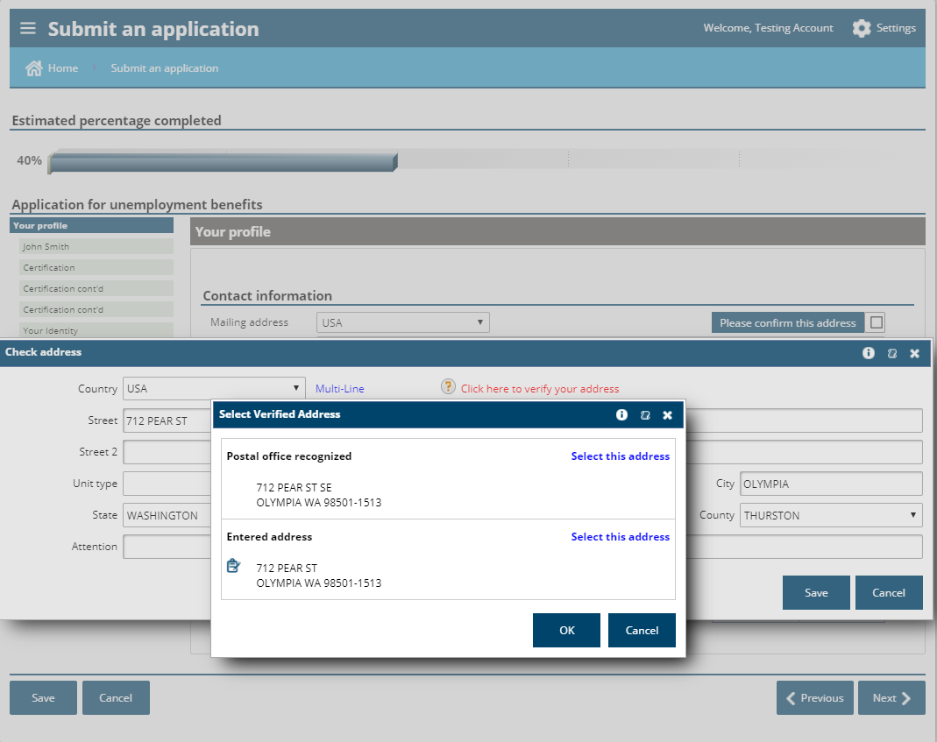

Slide 29
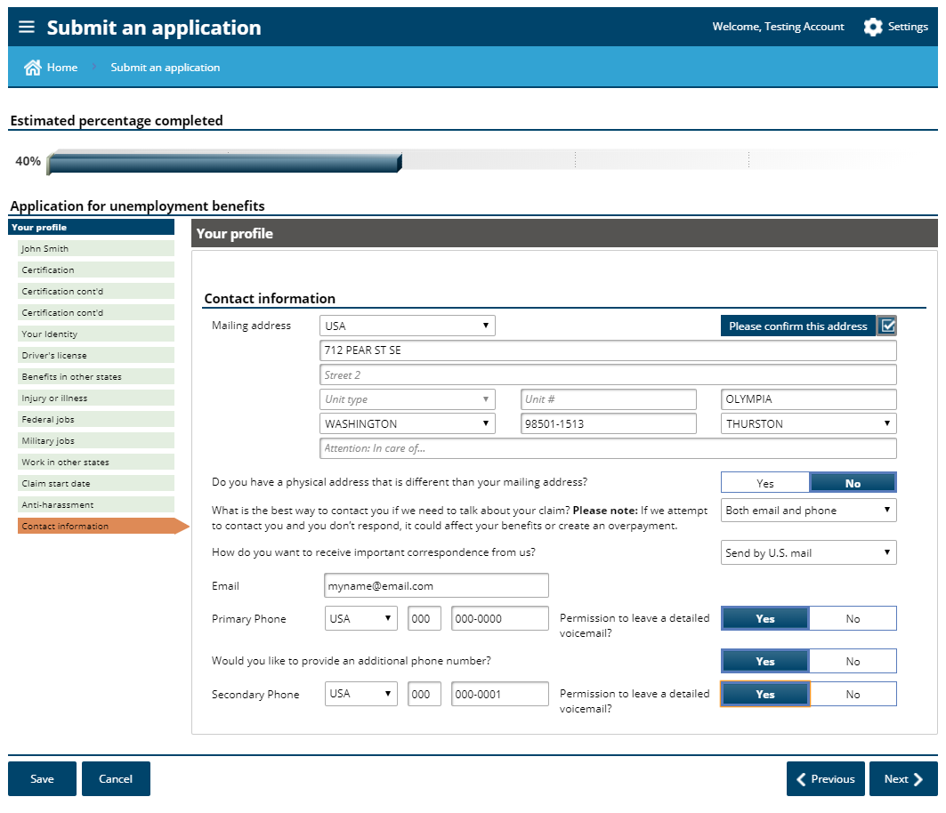

Slide 30
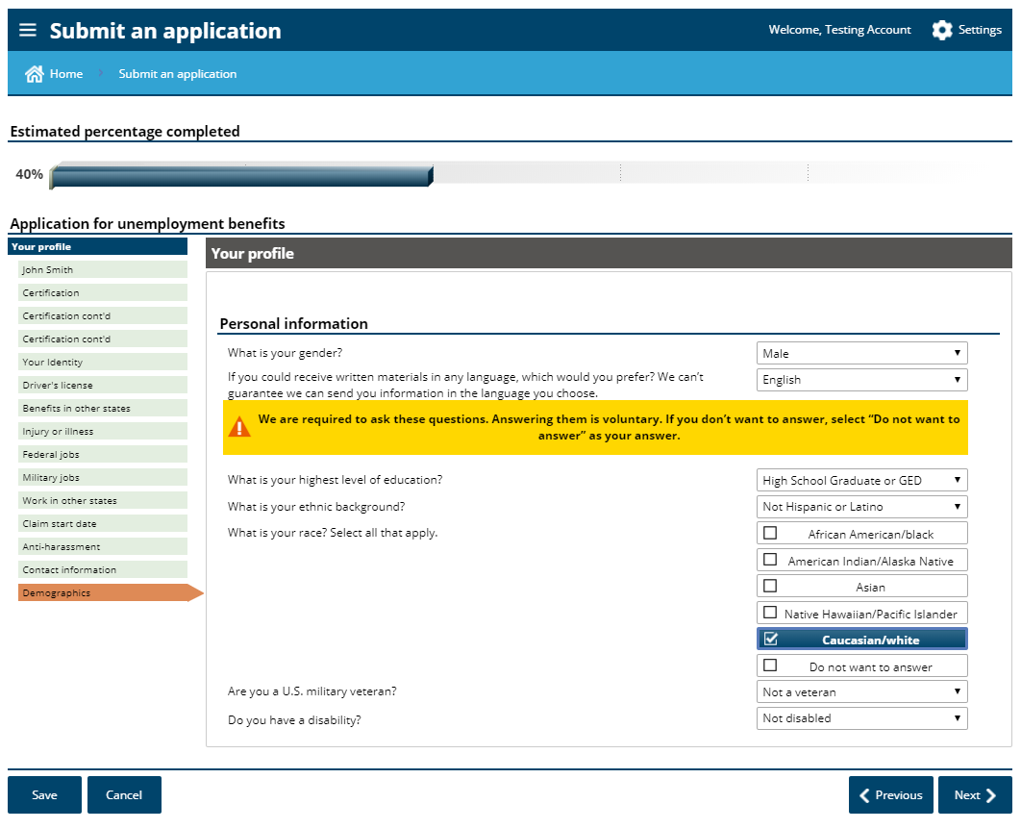

Slide 31
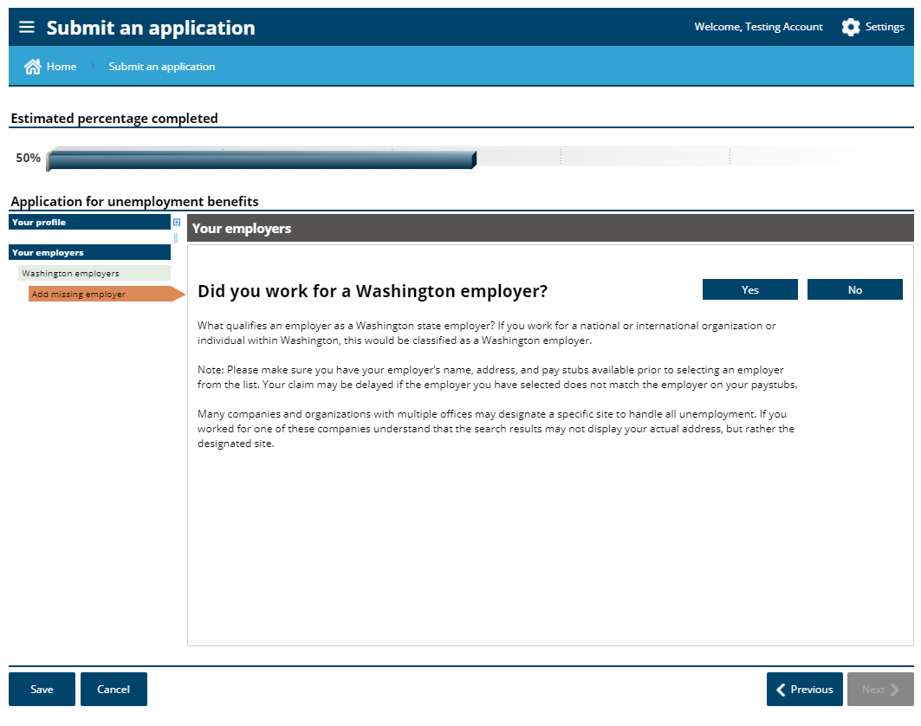
If you only had self employment, choose “no”.
If you had both, enter your employer here and your self employment later.

Slide 32
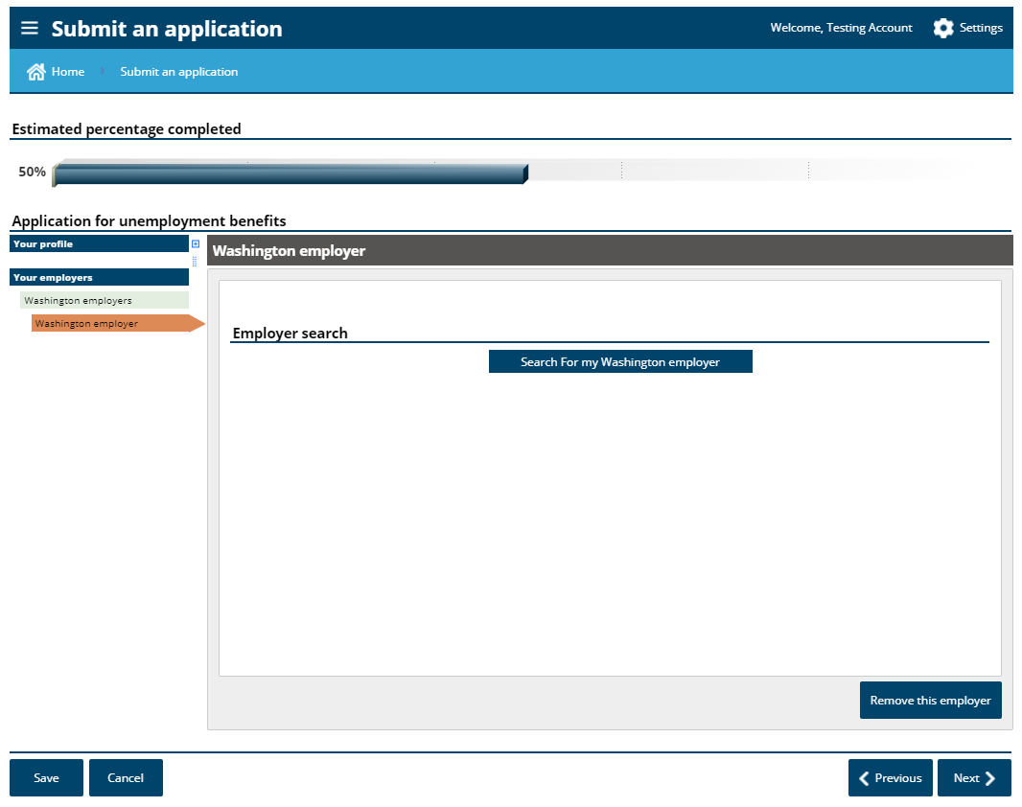

Slide 33
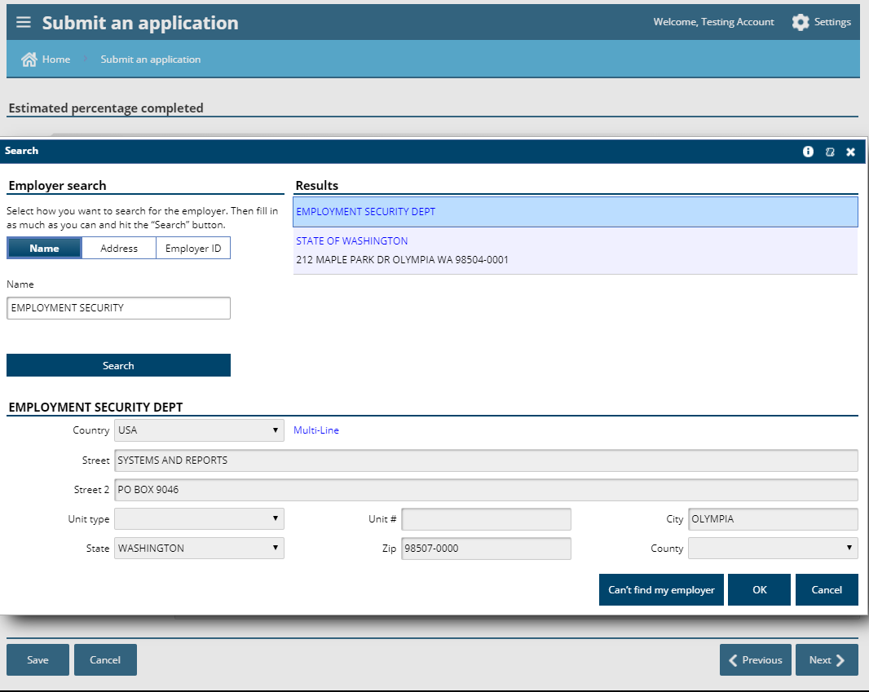

Slide 34
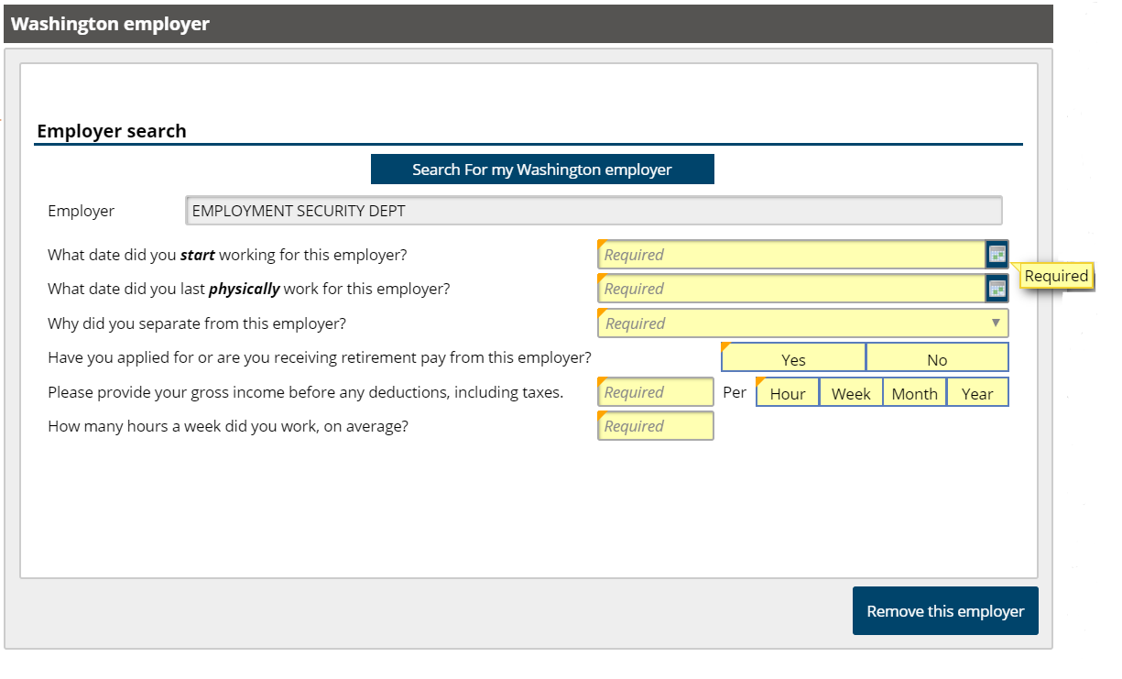

Slide 35
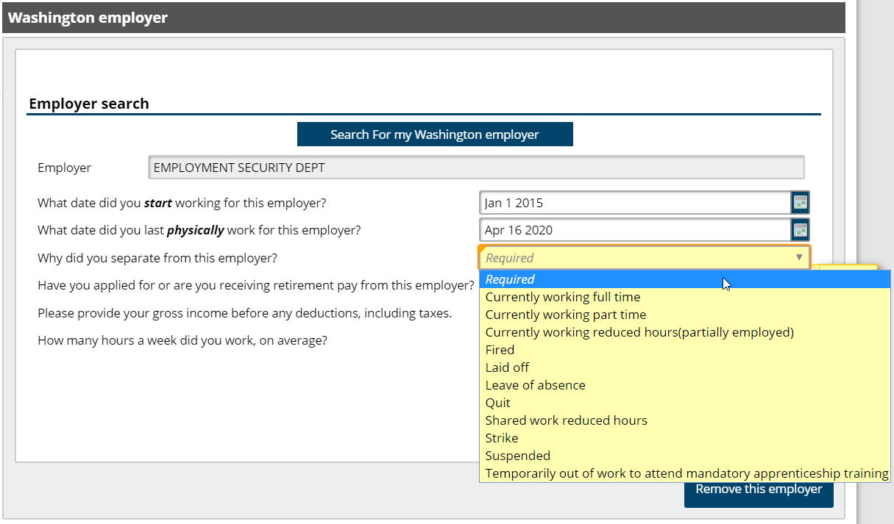

Slide 36
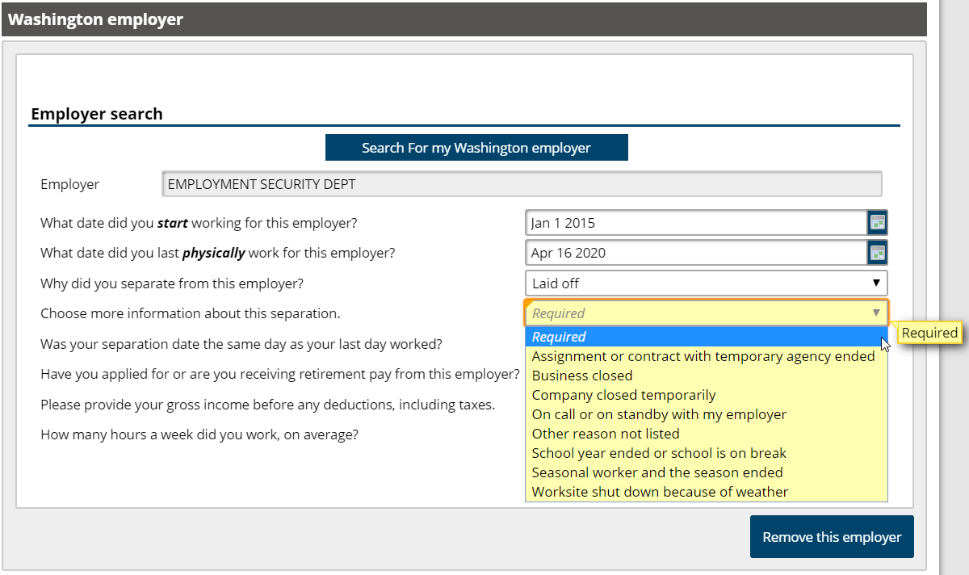

Slide 37
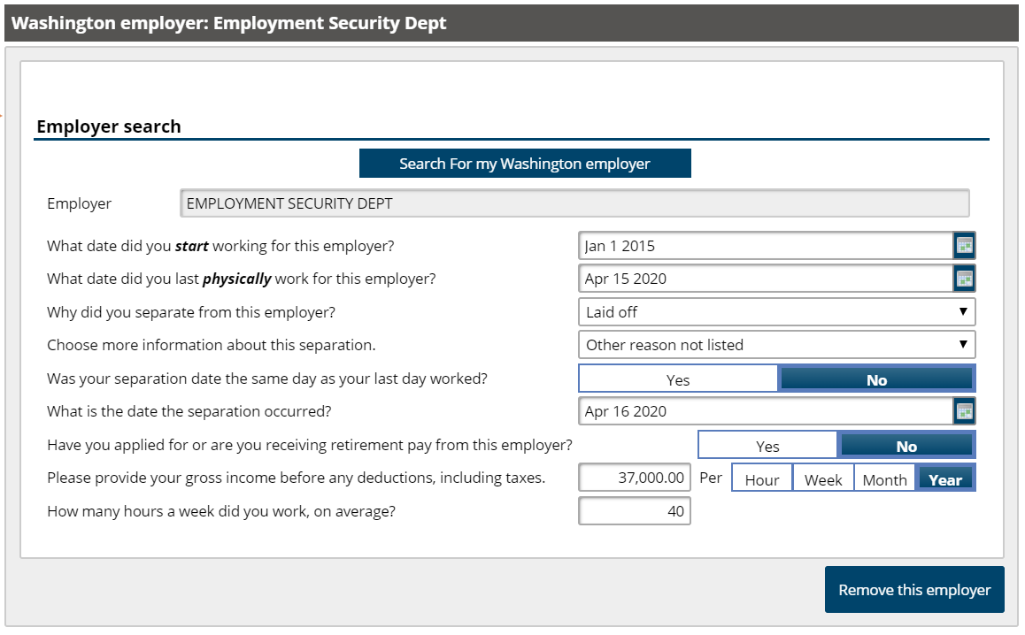

Slide 38
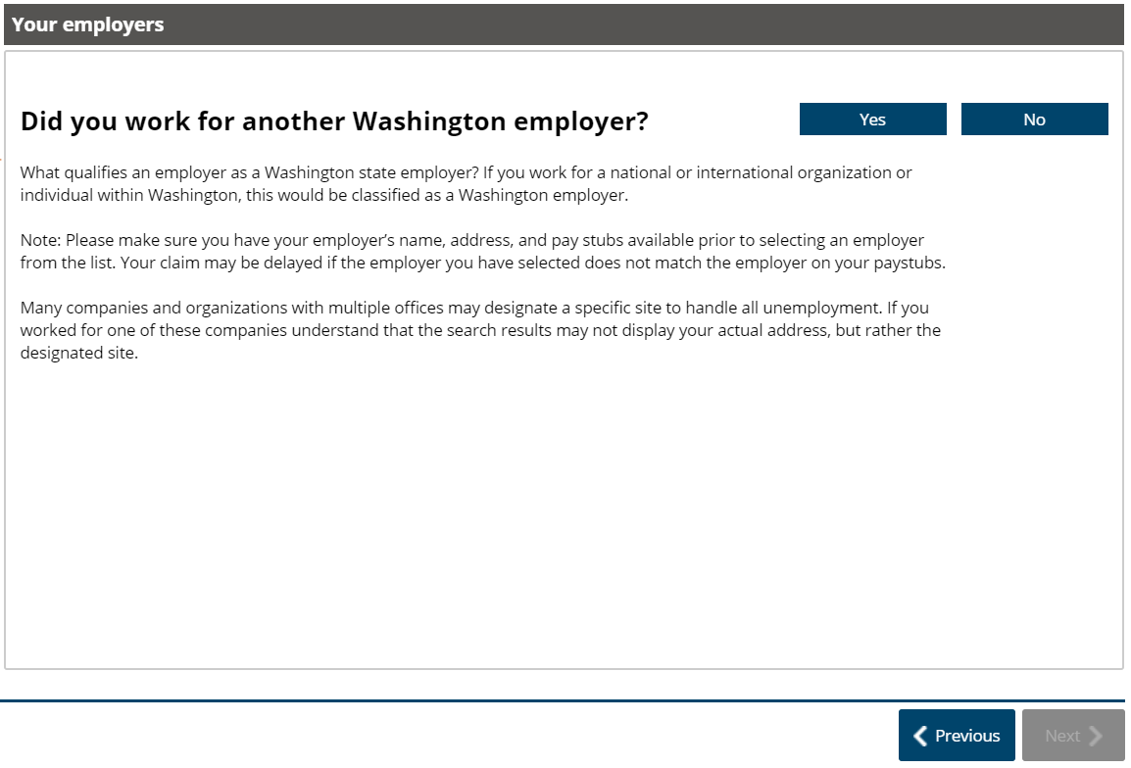

Slide 39
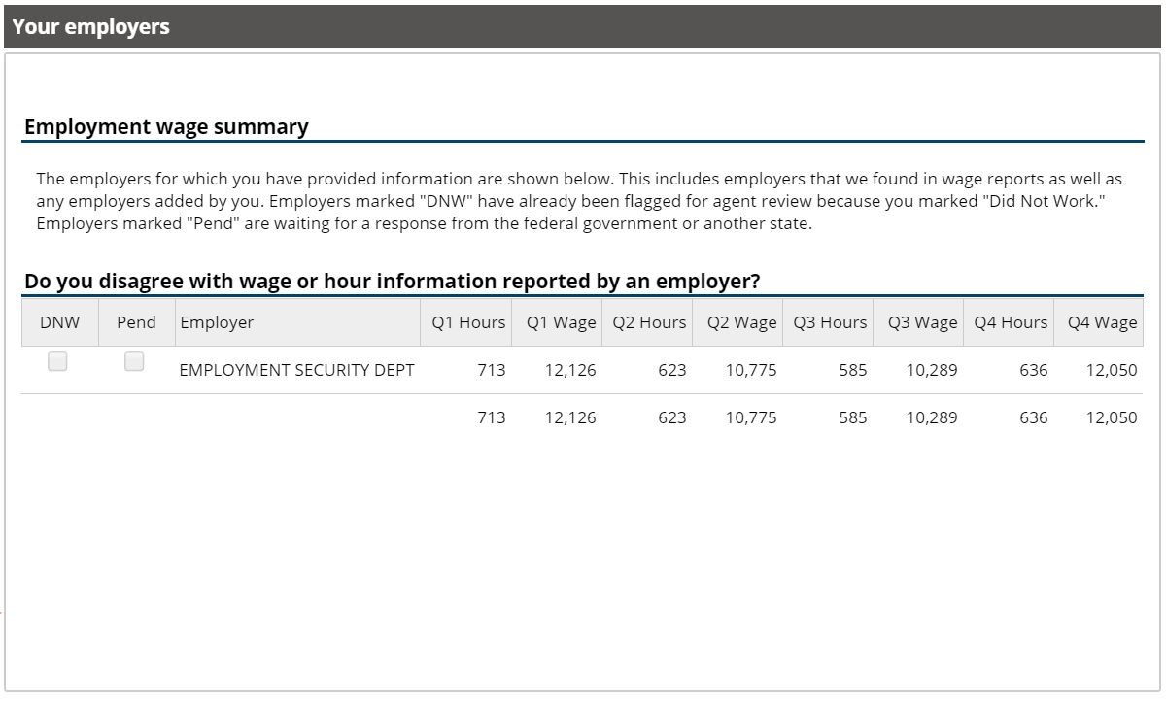

Slide 40
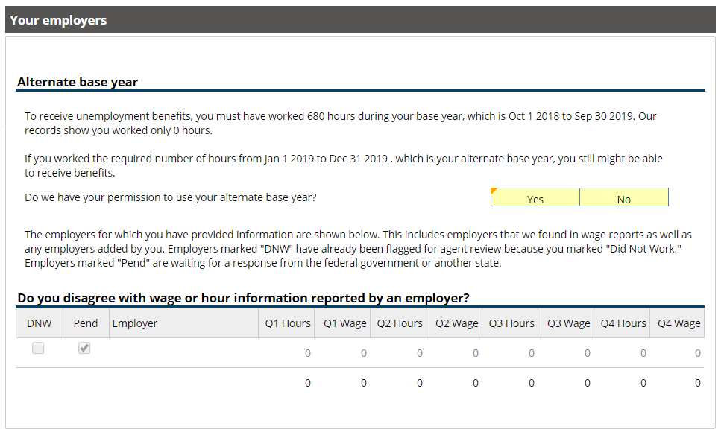

Slide 41
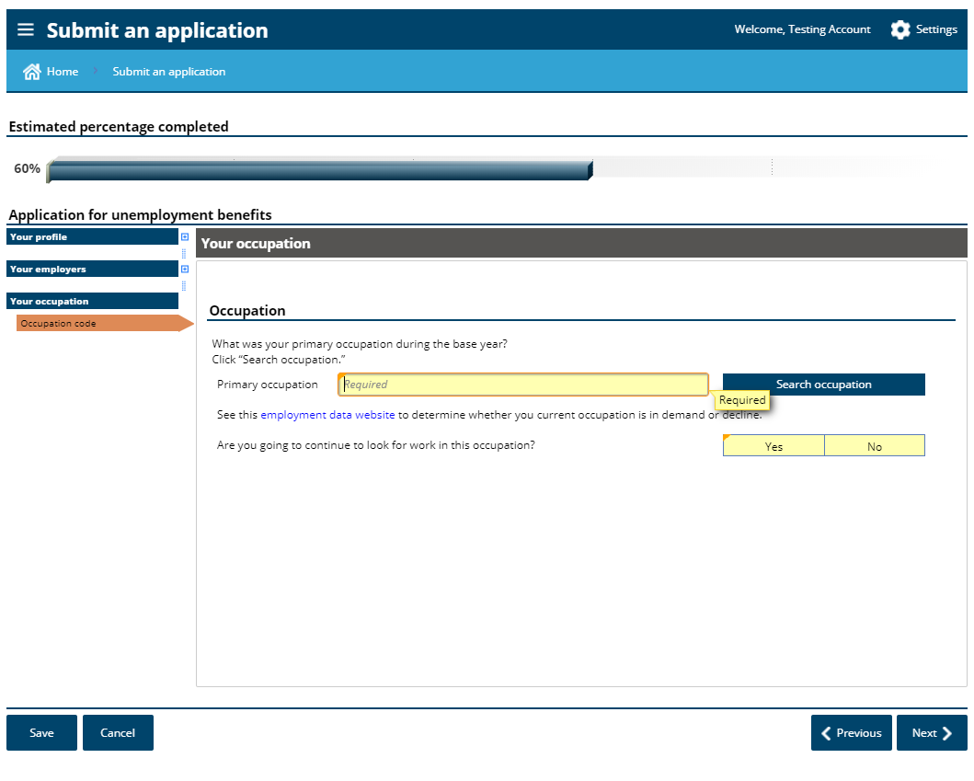

Slide 42
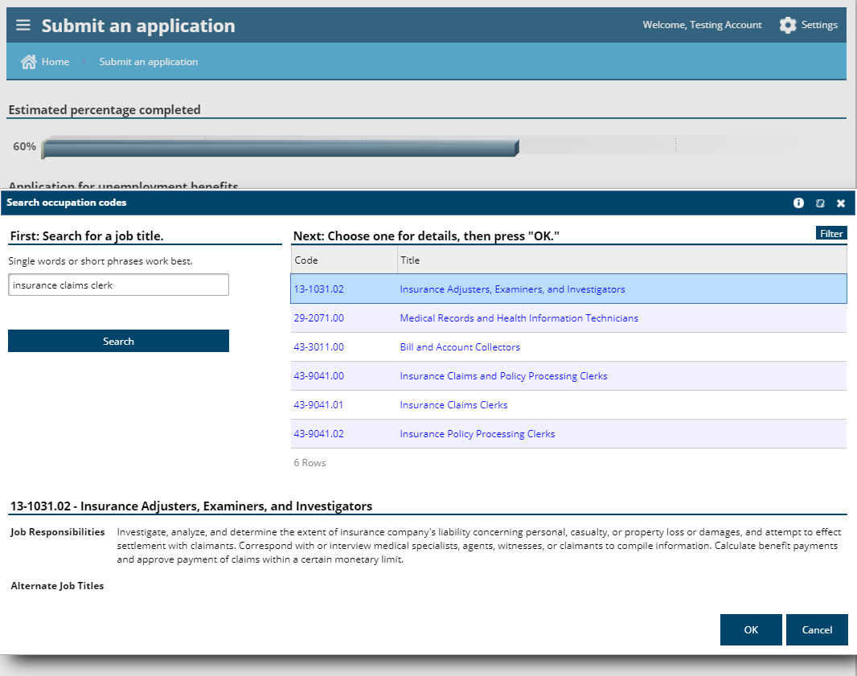

Slide 43
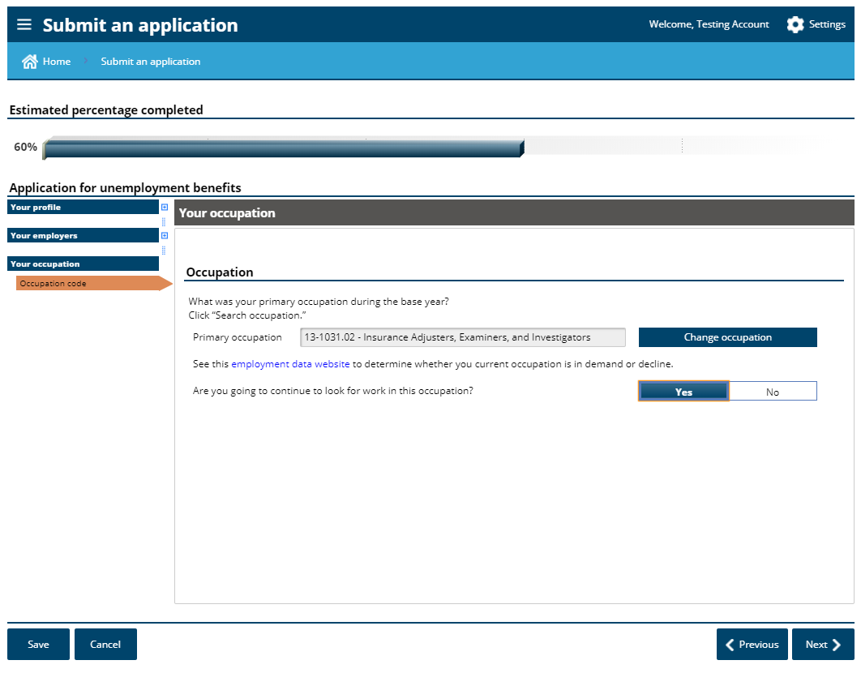

Slide 44
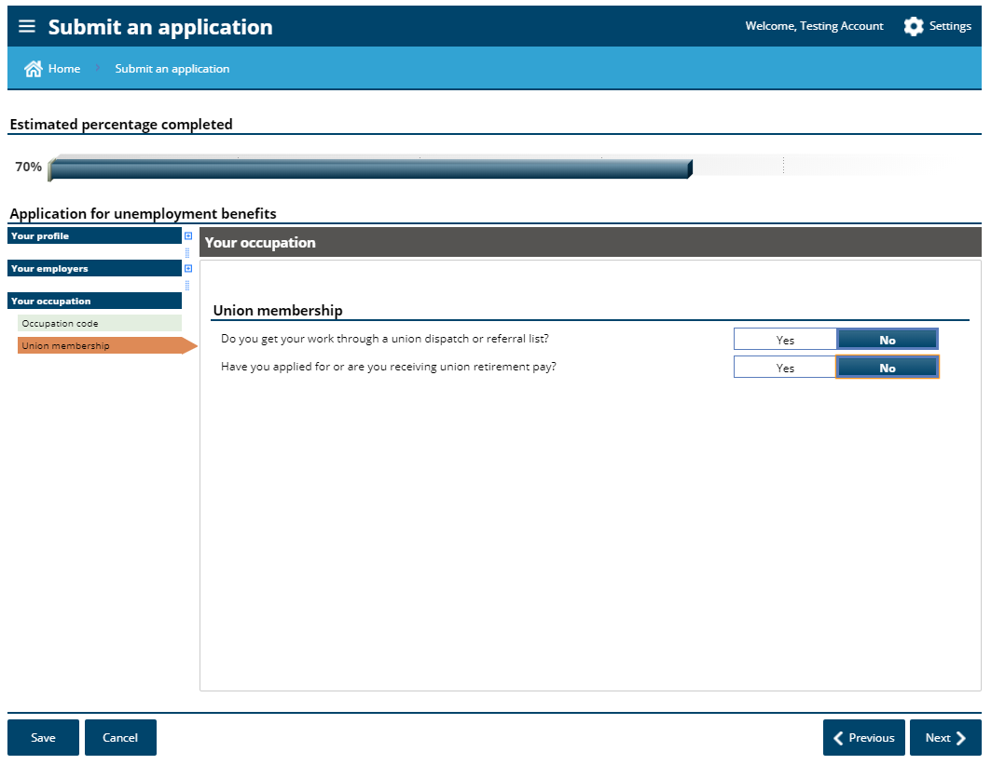

Slide 45
Work Search Requirements -
Conducting a work search is optional.
When filing your weekly claim, you will be asked if you made a work search. Answer it truthfully.
If you did not make three or more contacts, then you should answer the question “no”.
If you do answer “yes”, it will require you to enter at least three work search contacts.
If you do answer it with “no”, during the COVID-19 situation that will be ok. This will not stop you from receiving benefits.
We recommend not requesting standby until “stay at home” order is lifted and work search becomes required again.

Slide 46
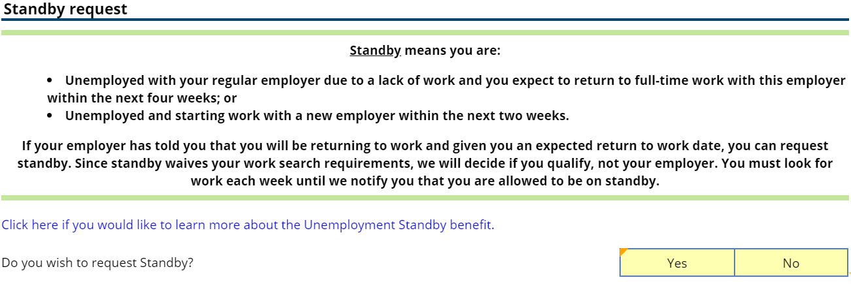
Requesting standby is not necessary while the “stay at home” order is in effect and while conducting a work search is optional.

Slide 47
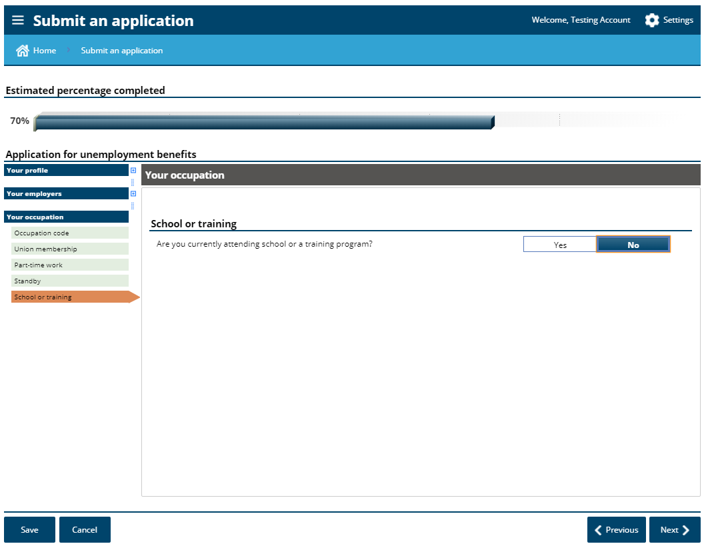

Slide 48
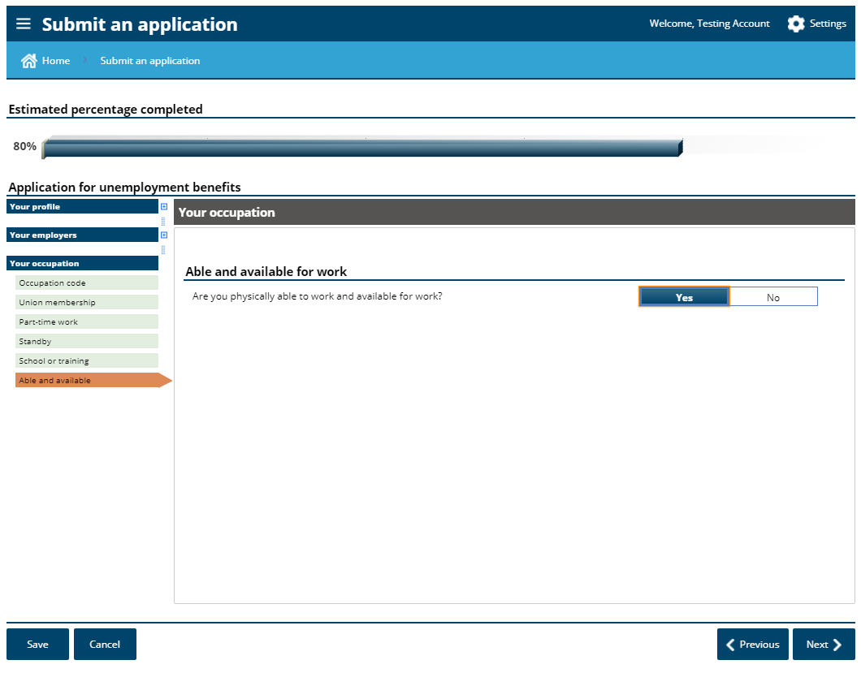
Being able and available means that you can go to work if called, if your employer had employment for you, and that there are no personal barriers to you returning to work.

Slide 49
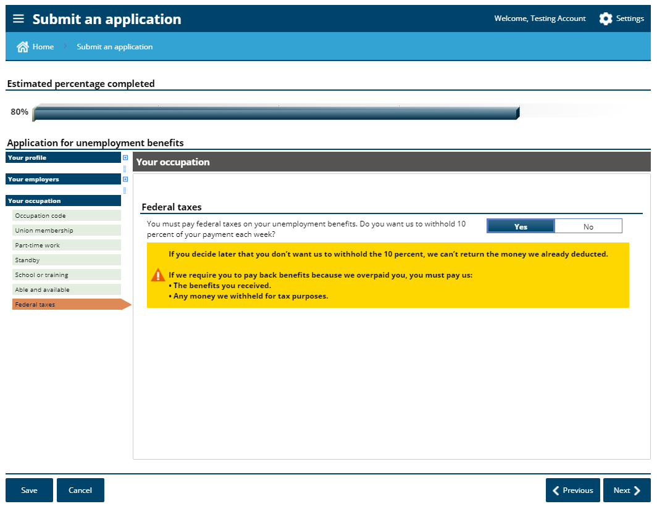

Slide 50
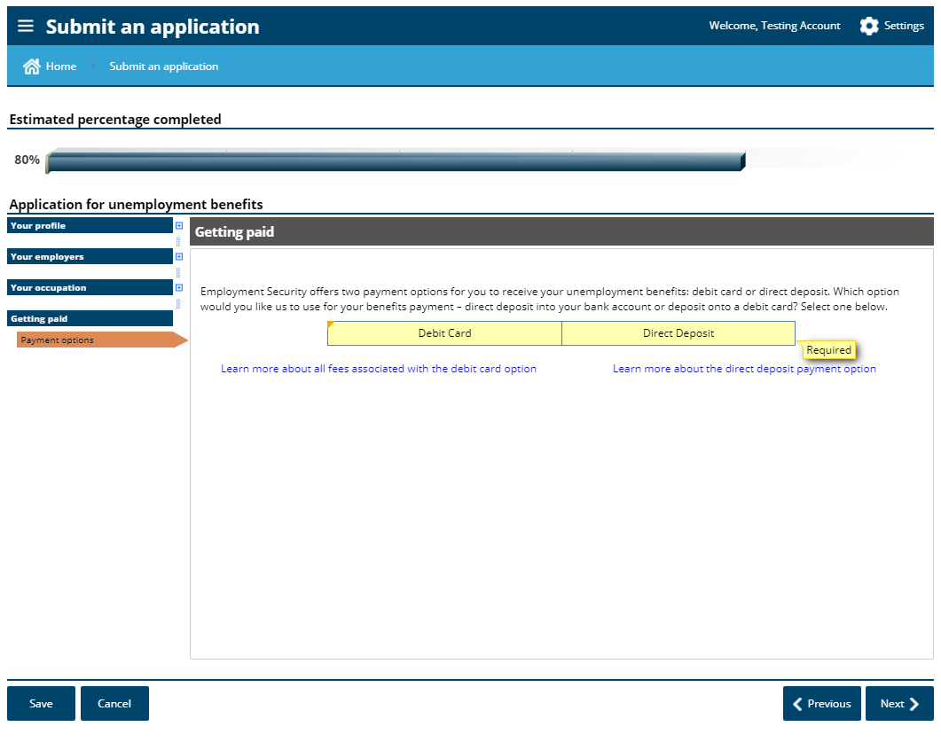

Slide 51
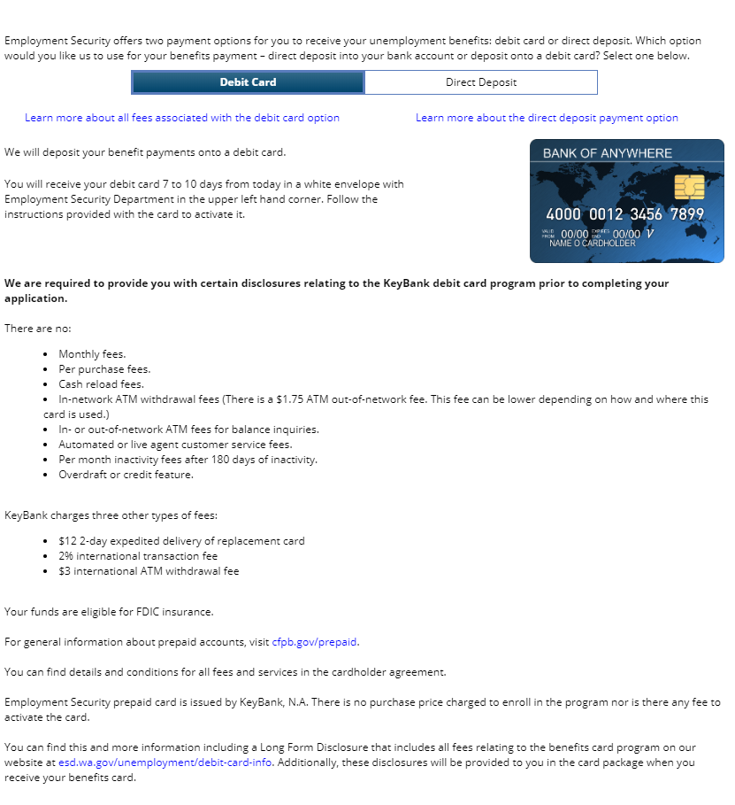

Slide 53
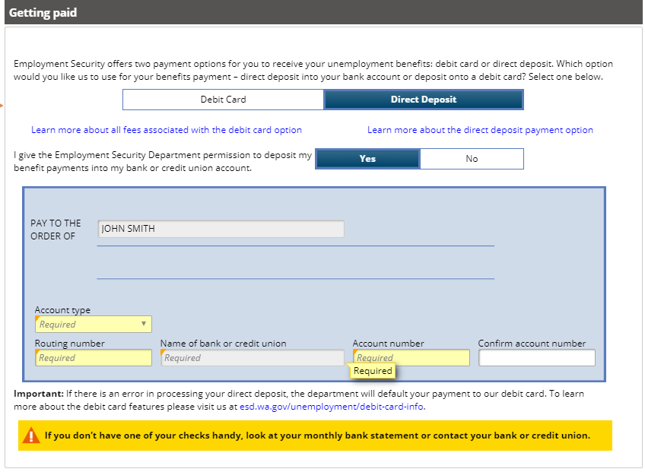

Slide 54
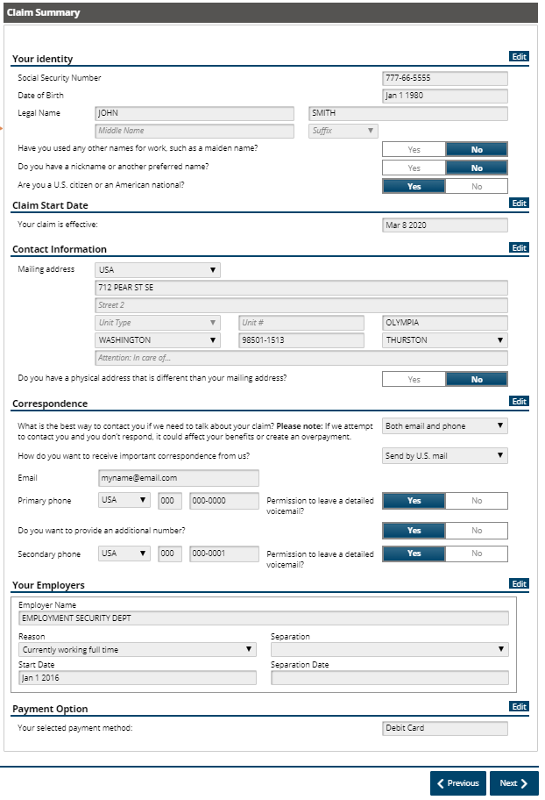

Slide 55
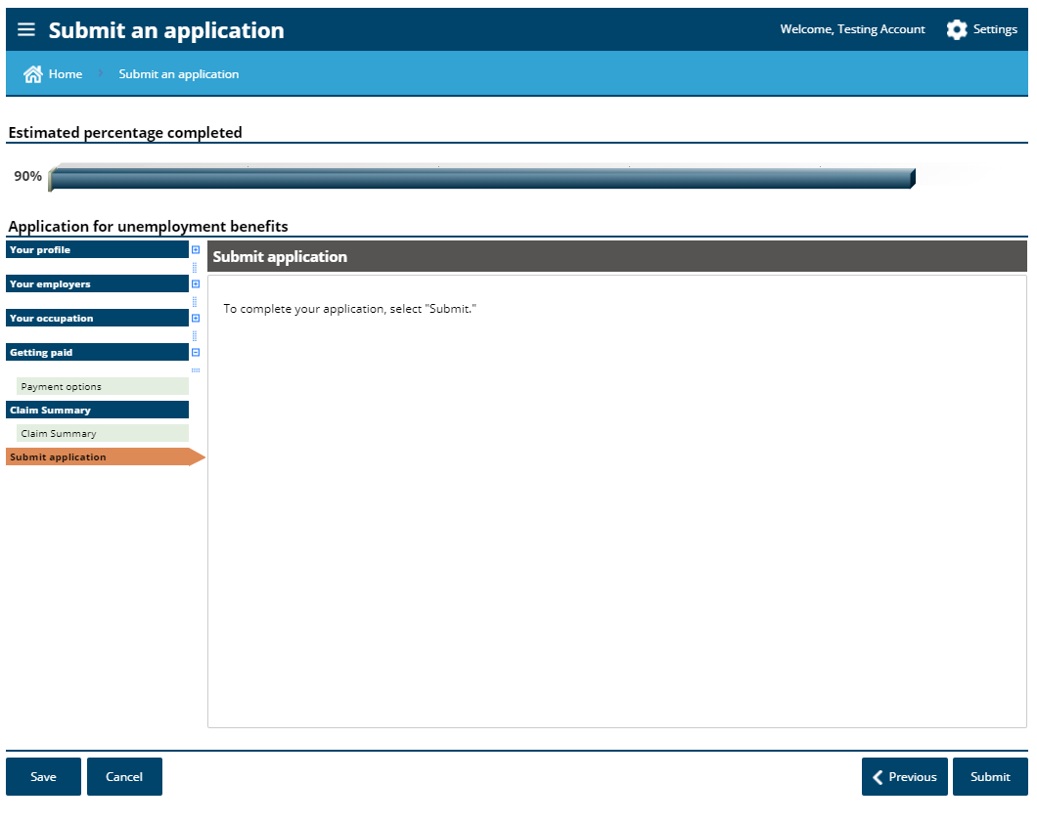

Slide 56
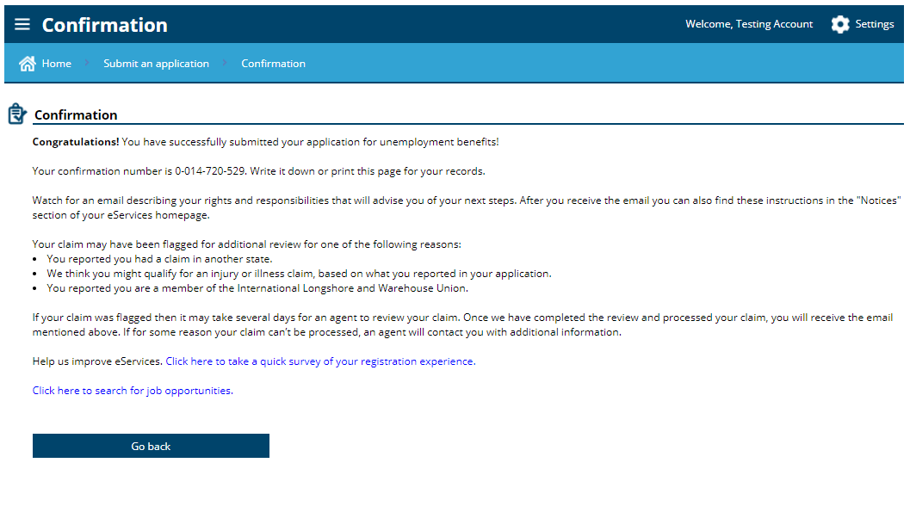

Slide 57
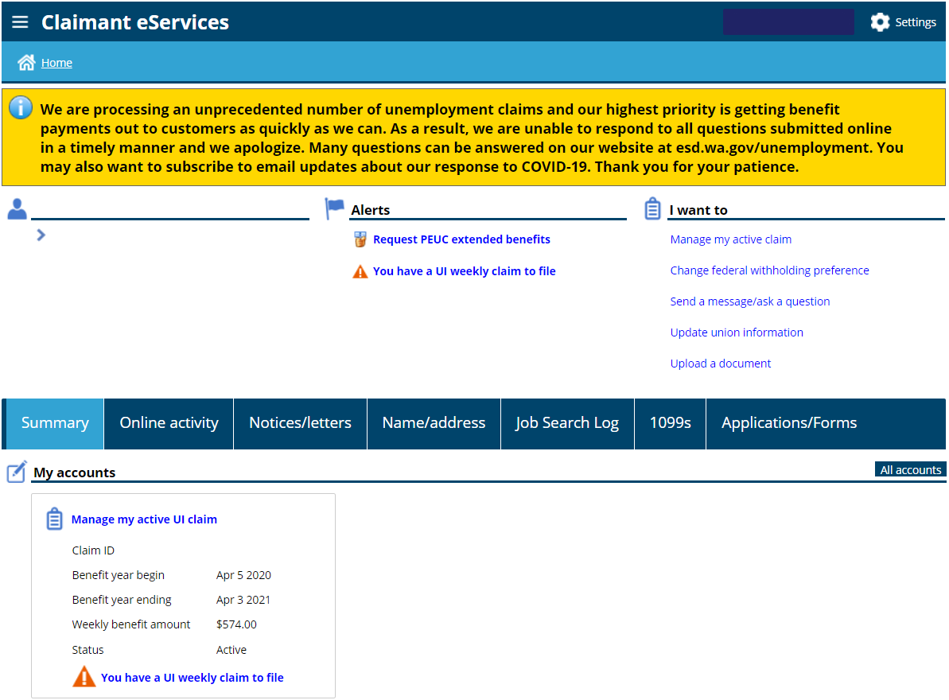
If you qualify for regular unemployment, you do not need to go further.

Slide 58
If you are not already, sign into your SAW account. www.esd.wa.gov
Type your Username and Password and click Sign in

Slide 60
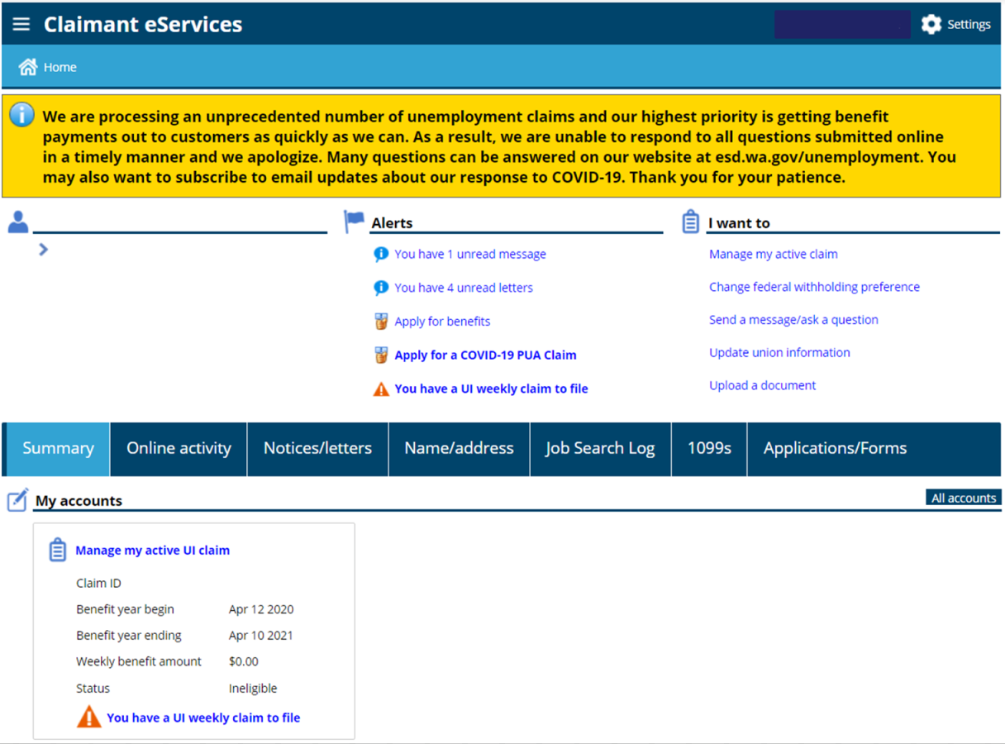

Slide 61
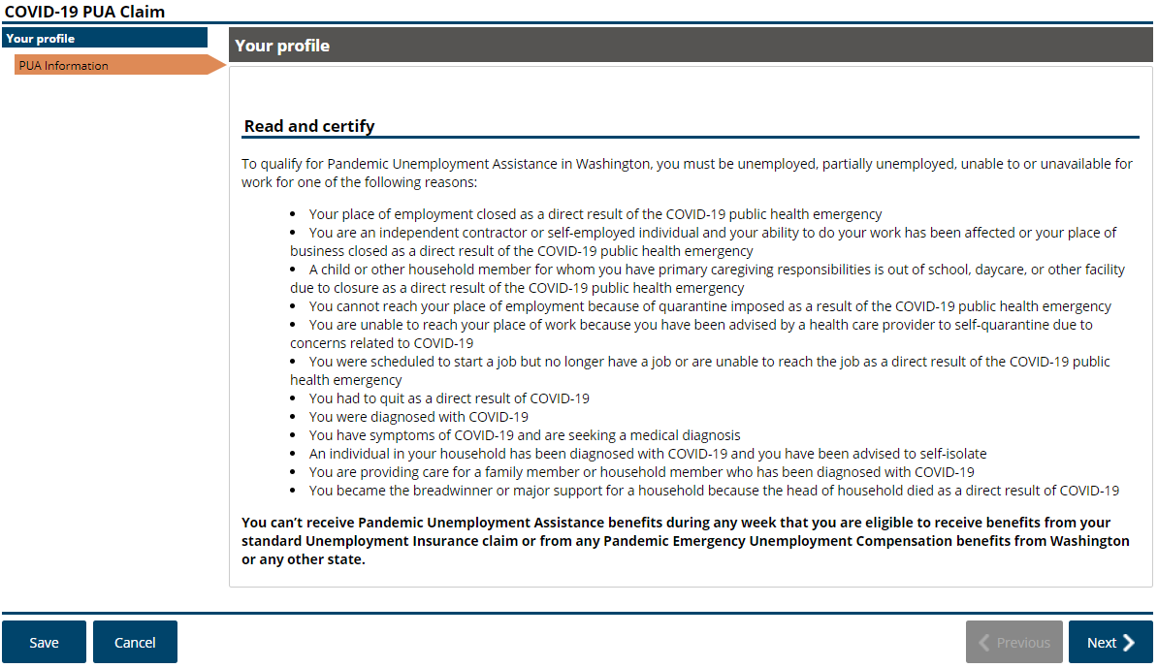

Slide 62
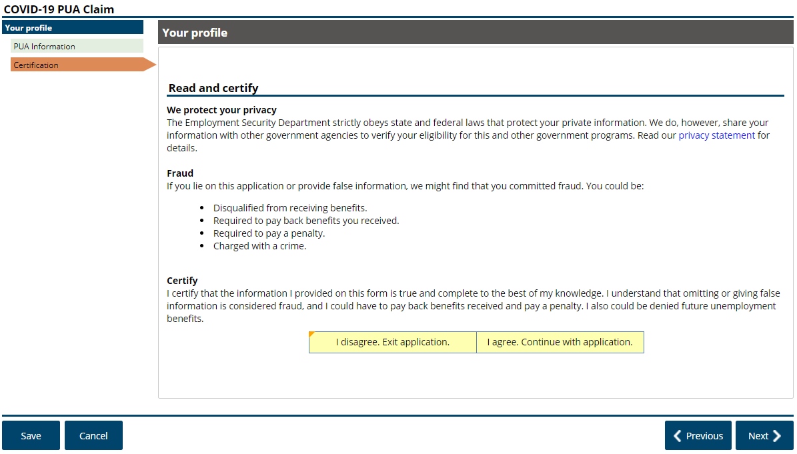

Slide 63
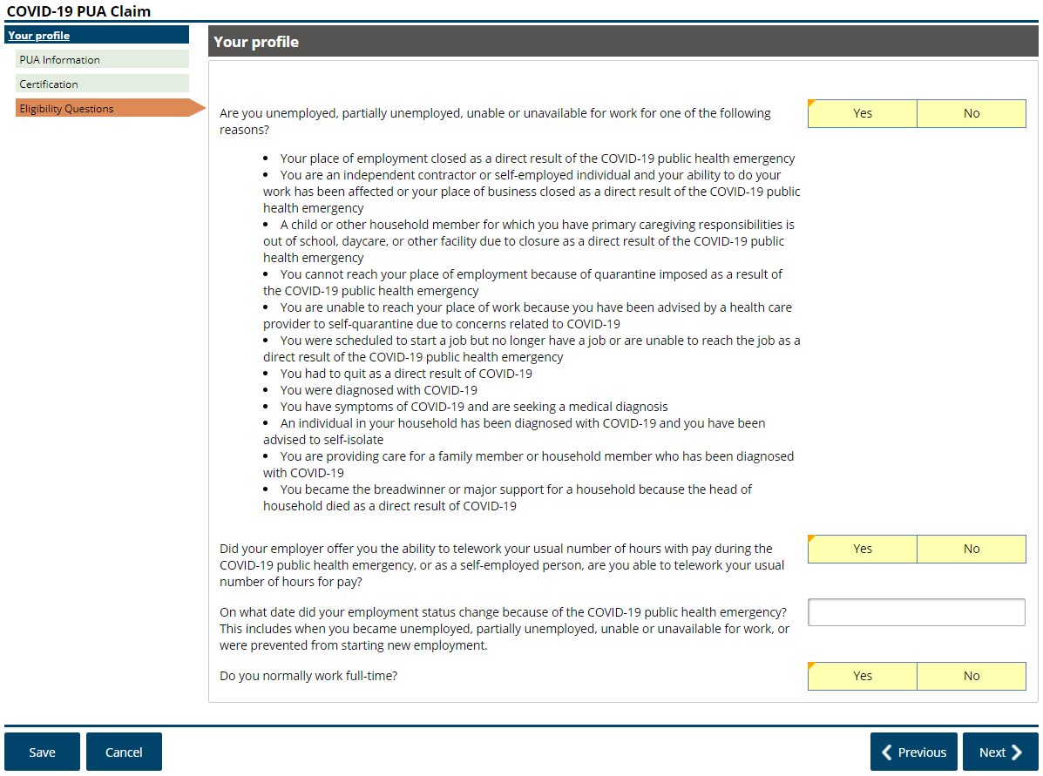

Slide 66
If yes, you will be prompted to enter more information

Slide 76
Let’s talk about two specific questions about why you are not working

Slide 80
These are end dates for the entire quarter. The Mar 31 date, means earnings Jan 1-Mar 31.

Slide 81
Example List of acceptable documents -
1125-E - compensation in column F
W2 – Line 5
1040-Single Filing, line 11b
1040 -Joint Filing, Line 31
Schedule C, Line 31
Schedule F, Line 34
1099-Misc – Box 3 or 7
1040-SE – Box 2
1065 Schedule K-1 – Box 14
Tax records from 2018 are not acceptable

Slide 87
Requesting standby is not necessary while the “stay at home” order is in effect and while conducting a work search is optional.

Slide 89
Being able and available means that you can go to work if called, if your employer had employment for you, and that there are no personal barriers to you returning to work.

Slide 98
If needed later

Slide 99
Unemployment Questions -
When do I file my weekly claims?
A = If you backdated your claim, now. Otherwise, preferable Sunday for each week that you want to receive benefits.
How do I file my weekly claim?
Using eServices, under the alert section, click on “You have a UI weekly claim to file”
What do I do when I return to work full time?
Just stop submitting your weekly claims
Will work search be required after the “stay at home” order is lifted?
Probably, but watch our website and look for alerts in your eServices account
Is the waiting week being waived?
A = Because of emergency rules put into place, yes.

Slide 100
More Unemployment Questions -
Can I receive unemployment if my employer (or self employment) has reduced my hours or is paying me some or all of my salary?
A = Yes, but you have to report the hours and earnings for each week this happens
Can I receive unemployment if my employer is paying me sick pay, vacation pay, or personal time off?
A = Yes, but you have to report the earnings for each week this happens
What is the base year?
A = Starting April 5th, it will be January 2019 through December 2019.
What if I don’t know my exact start/end dates?
A = Estimated start dates are ok, last date of work/self employment should be accurate

Slide 101
More Unemployment Questions -
I had both self employment and I worked for someone else. Do I apply through this process?
A = Yes, just answer both the self employment and the employer sections.
What is the difference and when do I apply for PUA and PEUC?
A = PUA – is an unemployment claim for those that do not qualify for regular unemployment. You apply for that as soon as you are not working or when work has reduced. PEUC – is for those that have used all the unemployment money in their account and need additional weeks to claim. You apply for that when you are nearing the end or have exhausted all the benefits in your regular claim.
All information and Frequently Asked Questions on www.esd.wa.gov

Slide 102
New Chatbot search feature -

Slide 103
Resources to Help!
For everything – www.esd.wa.gov
This includes COVID-19, as it relates to programs and services provided by the Employment Security Department
Presentation online – https://esd.wa.gov/newsroom/introduction-to-unemployment-insurance-public-webinar
eServices Account Support – 855-682-0785
Unemployment Insurance Claims – 800-318-6022
Unemployment Insurance Questions – 833-572-8400
Reemployment Services –
www.WorkSourceWA.com
State jobs – www.careers.wa.gov

