Slide 1
Unemployment Insurance
Specifically tailored for state employees to help prepare them for accessing unemployment insurance benefits. This information is current as of June 30th, 2020.

Slide 2
Topics we will cover
How to apply for unemployment benefits
How to submit a weekly claim each week
We will address when to file your initial and weekly claims
We will briefly discuss PFML and UI

Slide 3
Why the SharedWork Program?
Retain skilled workforce, reduce payrolls costs, serve as a smart alternative to full-layoffs…
Employees collect partial benefits to replace a portion of their lost wages.
Employees on SharedWork do not have to look for other work.
Employees must be available for all work offered by their regular employer.
Employers must continue to pay for employees’ health insurance.
This Photo by Unknown Author is licensed under CC BY

Slide 4
What you will need
Logged in and on the Internet, www.esd.wa.gov
Pen and paper
SSN, address, Date of birth
WA Drivers License or WA ID if you have one
Employer names, addresses, and dates of employment for past 18 months
Bank routing and account numbers – if you want to sign up for direct deposit today

Slide 5
Filing a New Unemployment Insurance Claim

Slide 6
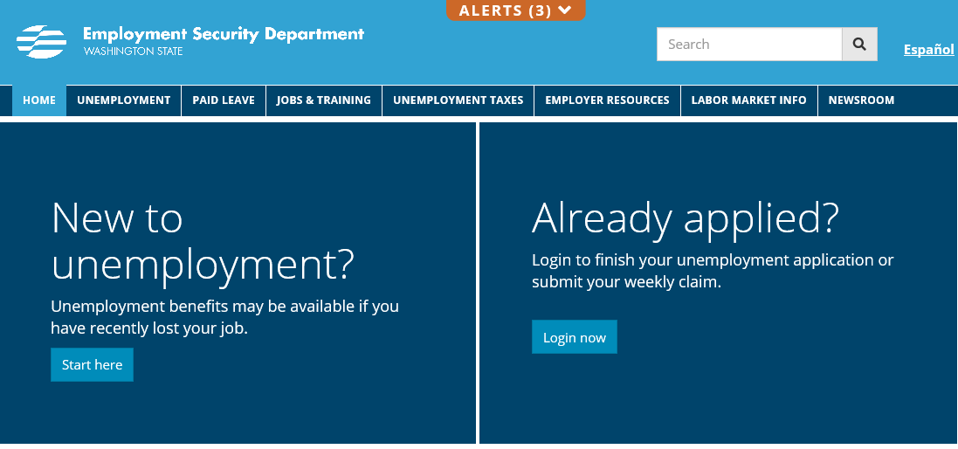
ESD.WA.GOV

Slide 7
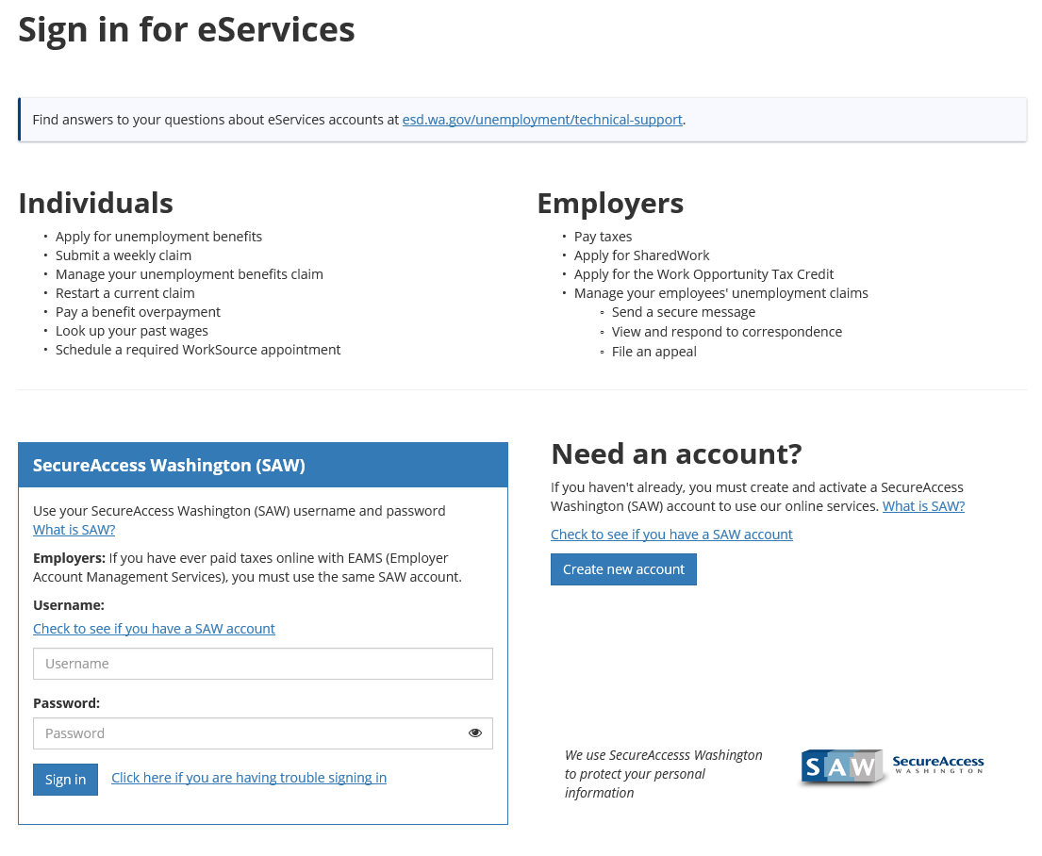

Slide 8
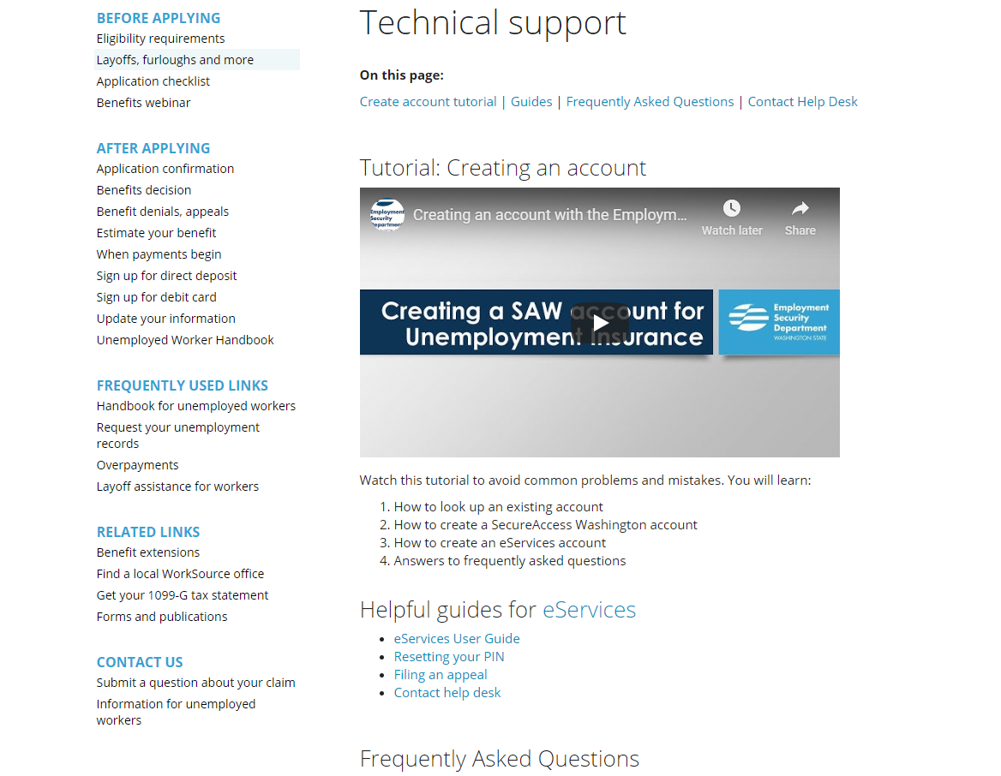

Slide 9
Type your Username and Password and click Sign in

Slide 10
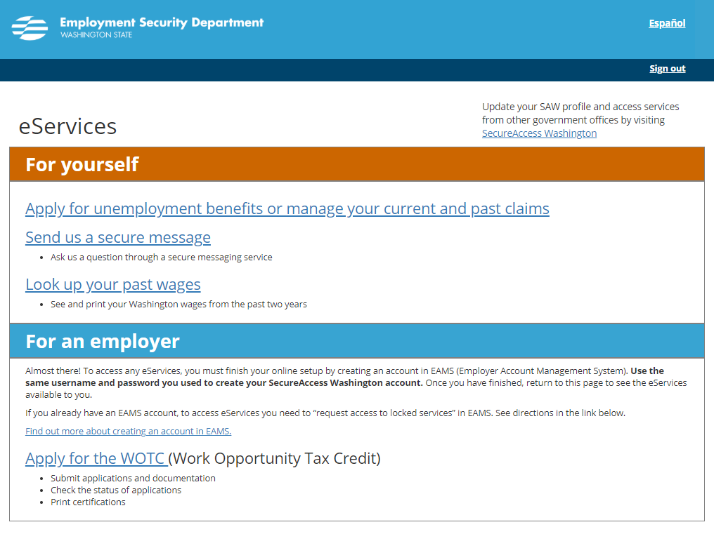

Slide 11
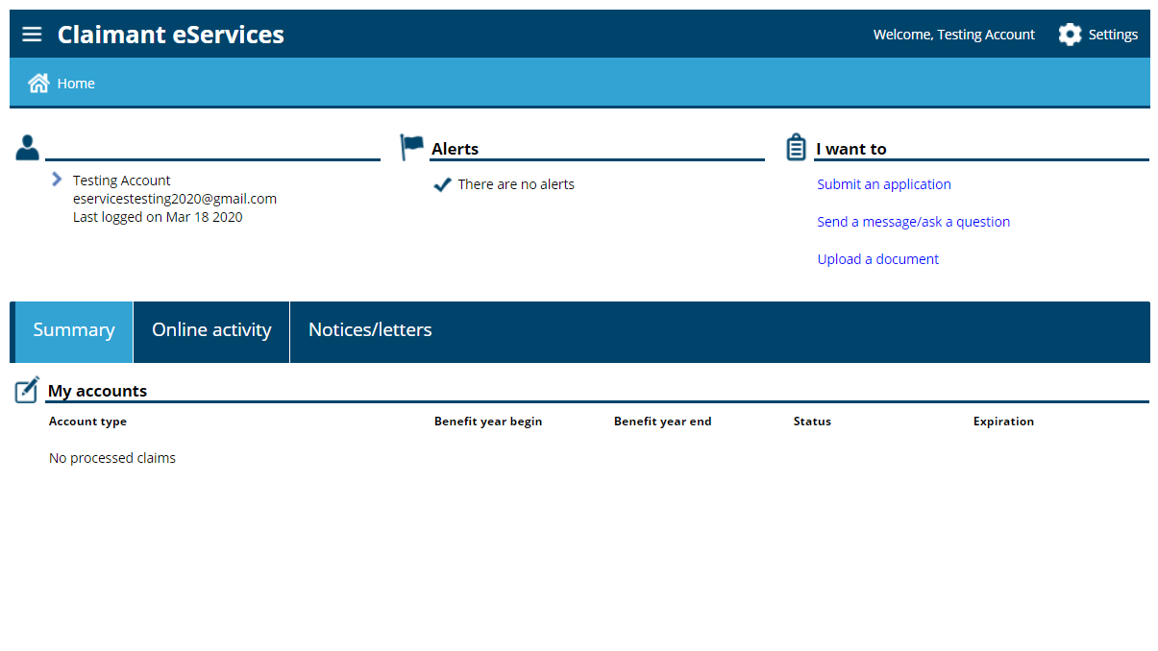

Slide 12
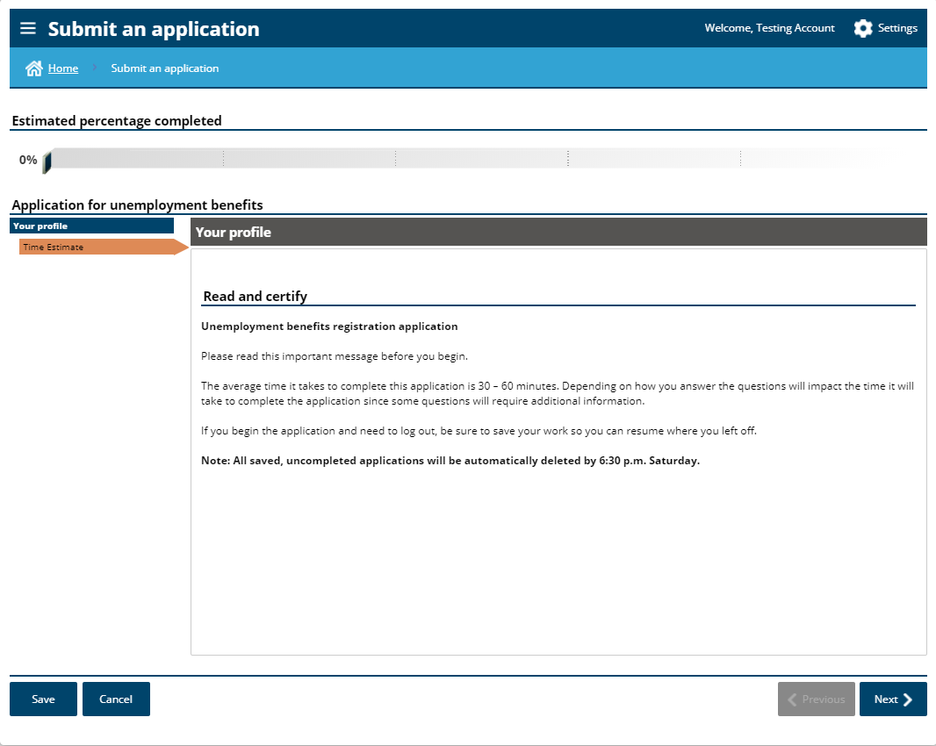

Slide 13
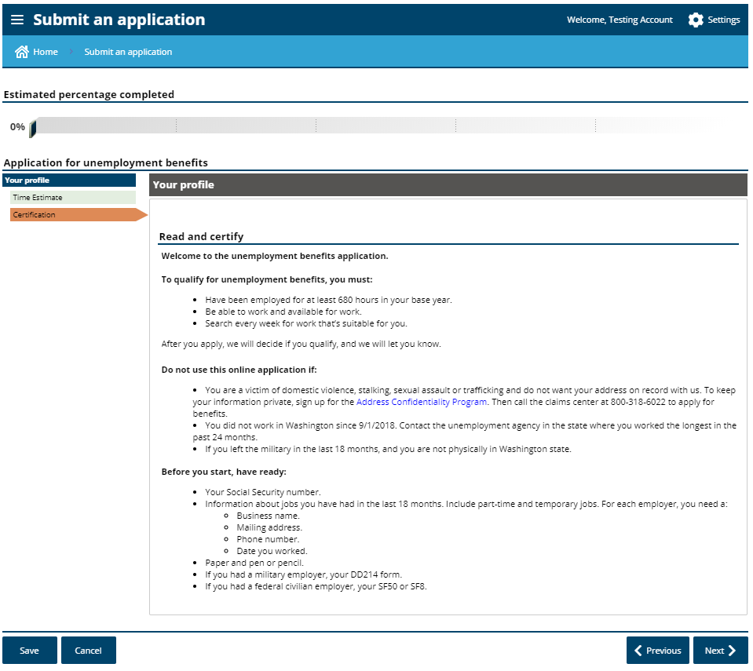

Slide 14
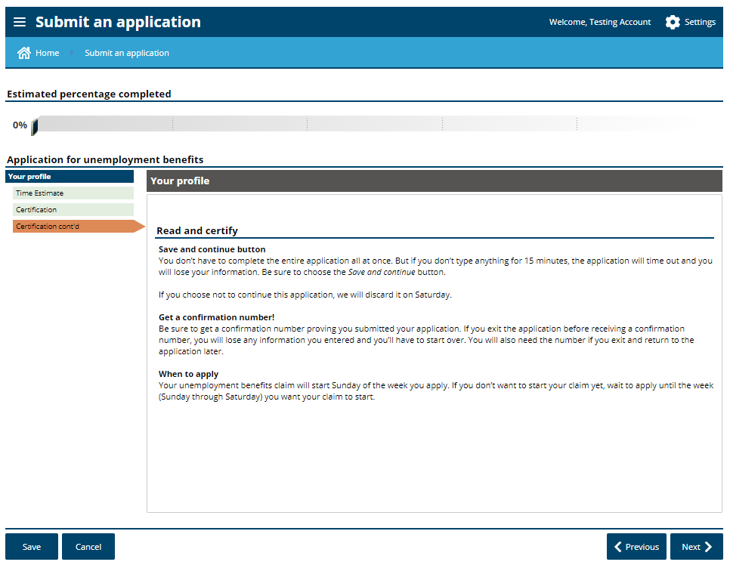

Slide 15
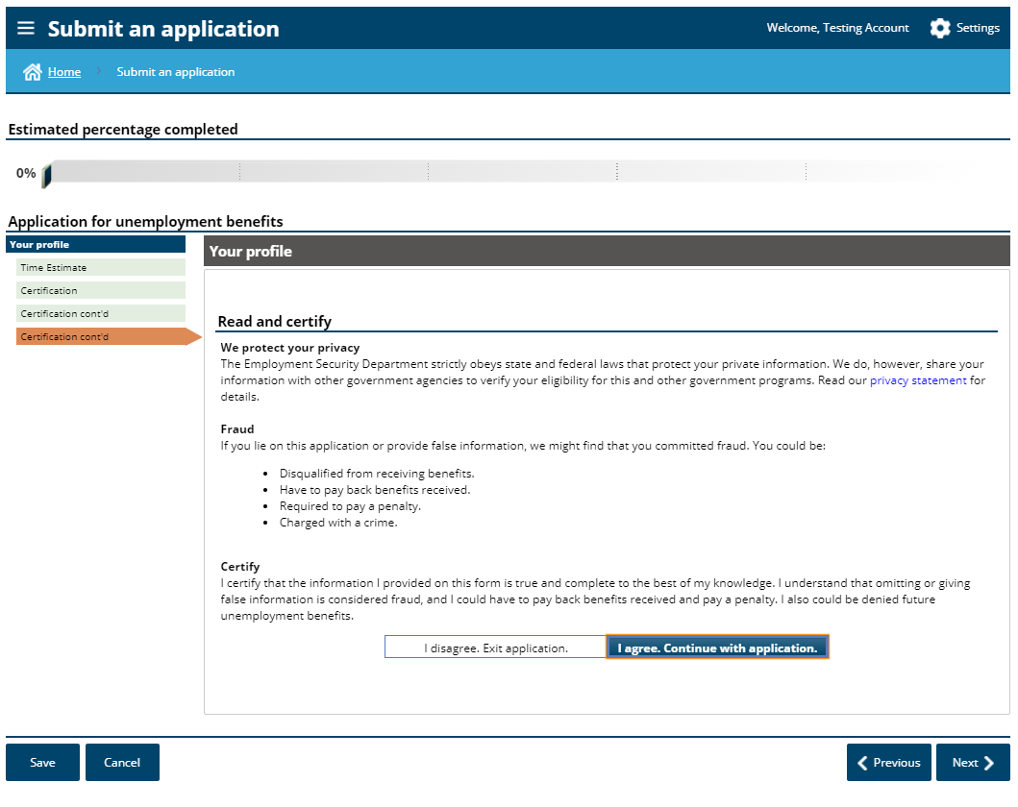

Slide 16
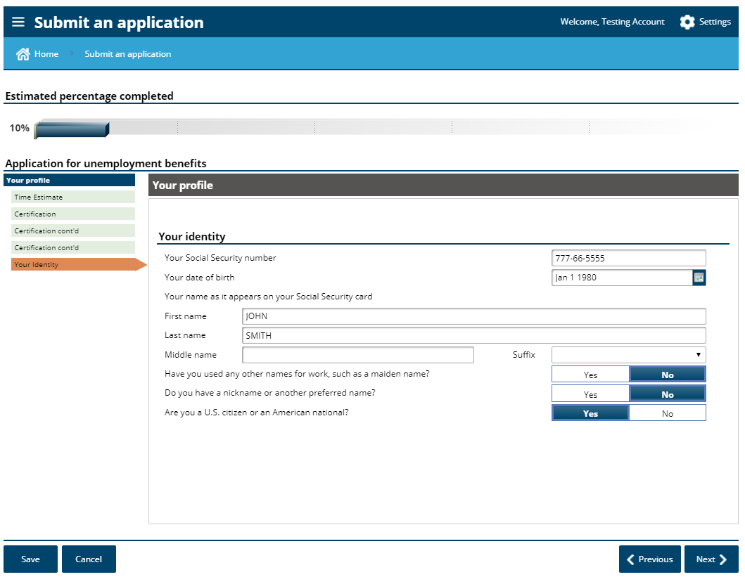
Be careful with this question

Slide 17
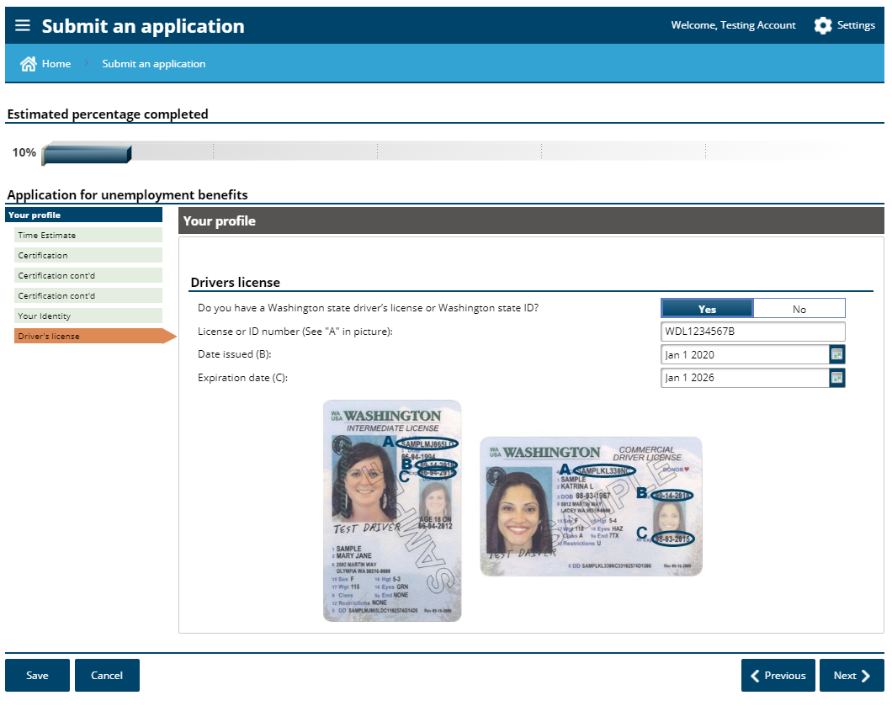

Slide 19
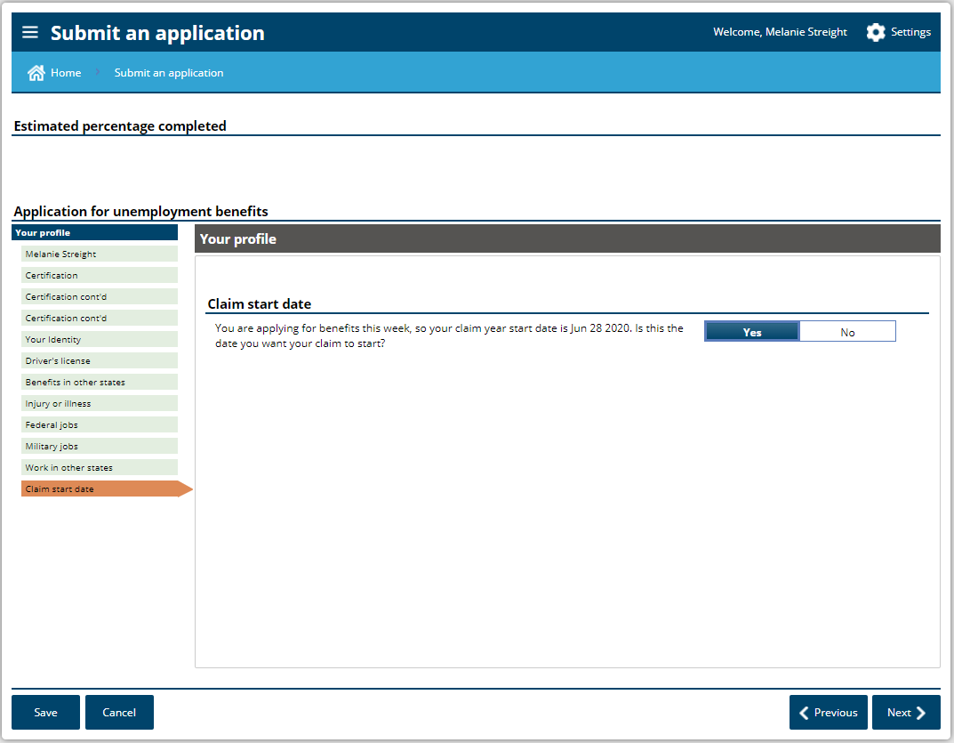
If your first furlough day is anytime between June 28th and July 4th, you can file your initial claim/application any day during the week and you will have a start date of 6/28.

Slide 20
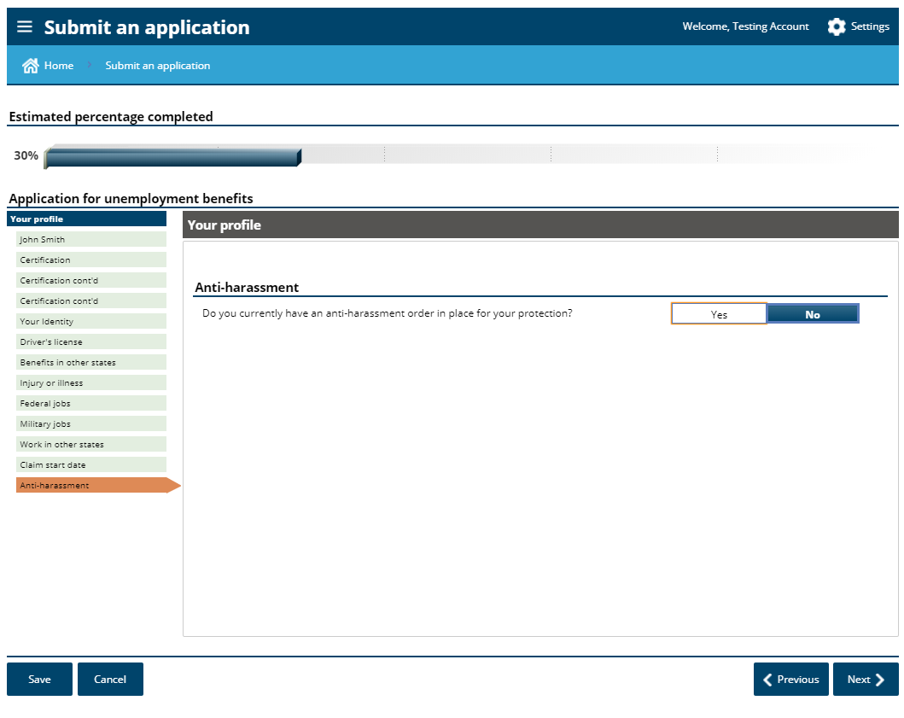

Slide 21
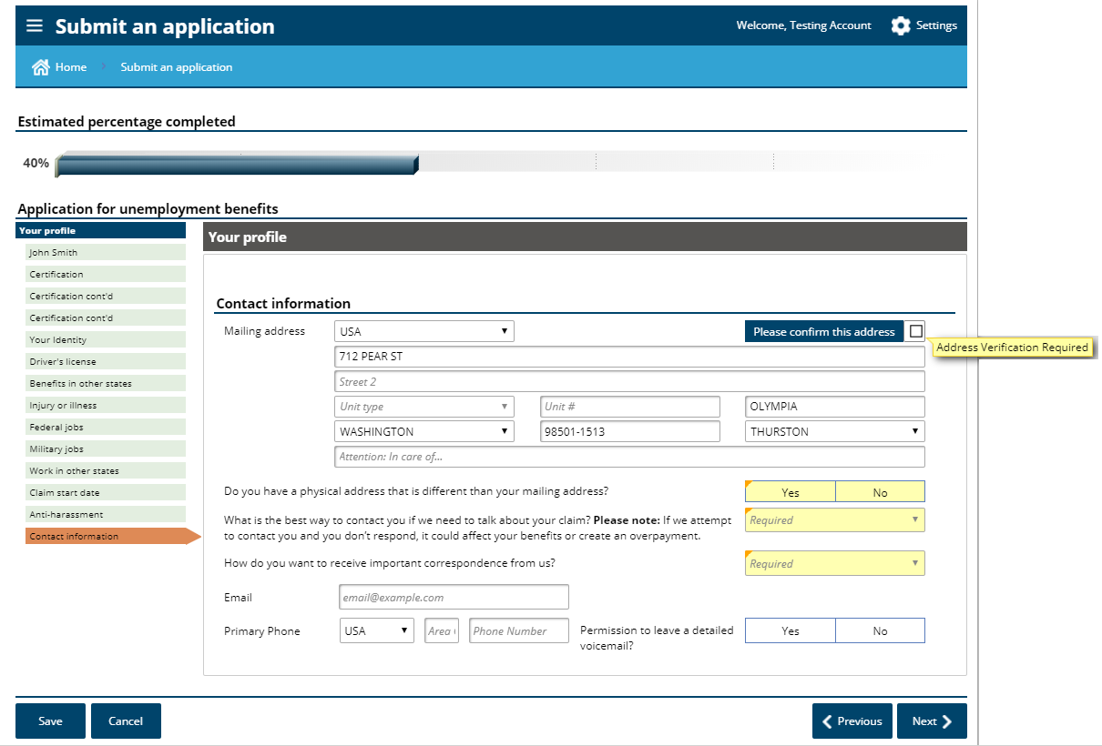

Slide 22
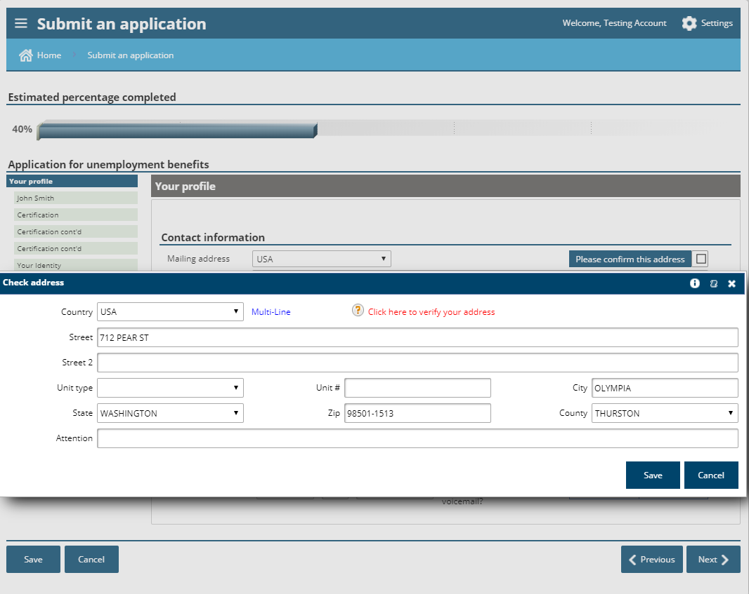

Slide 23
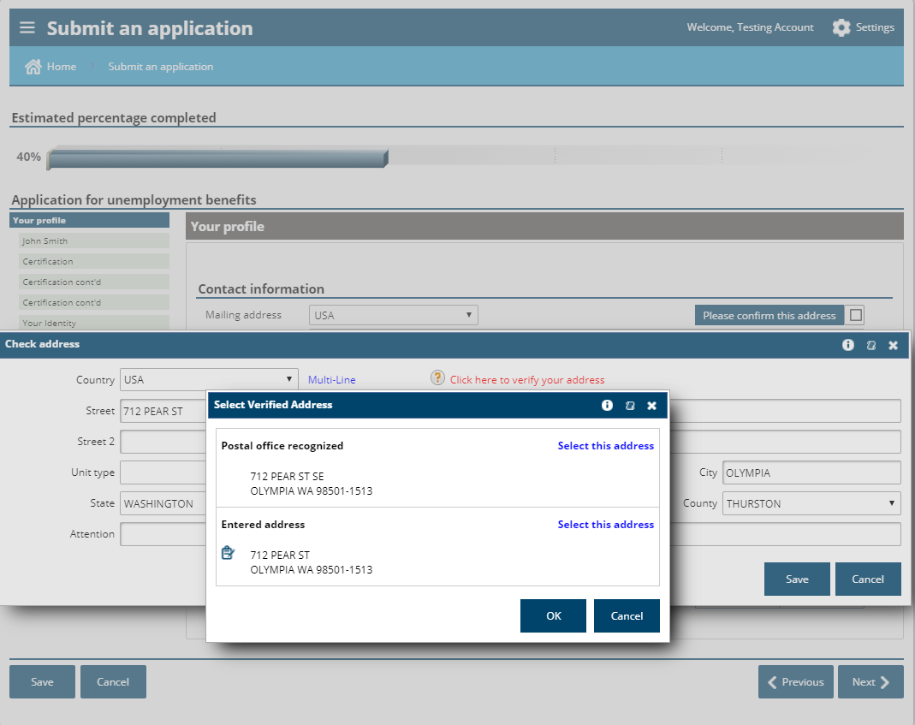

Slide 24
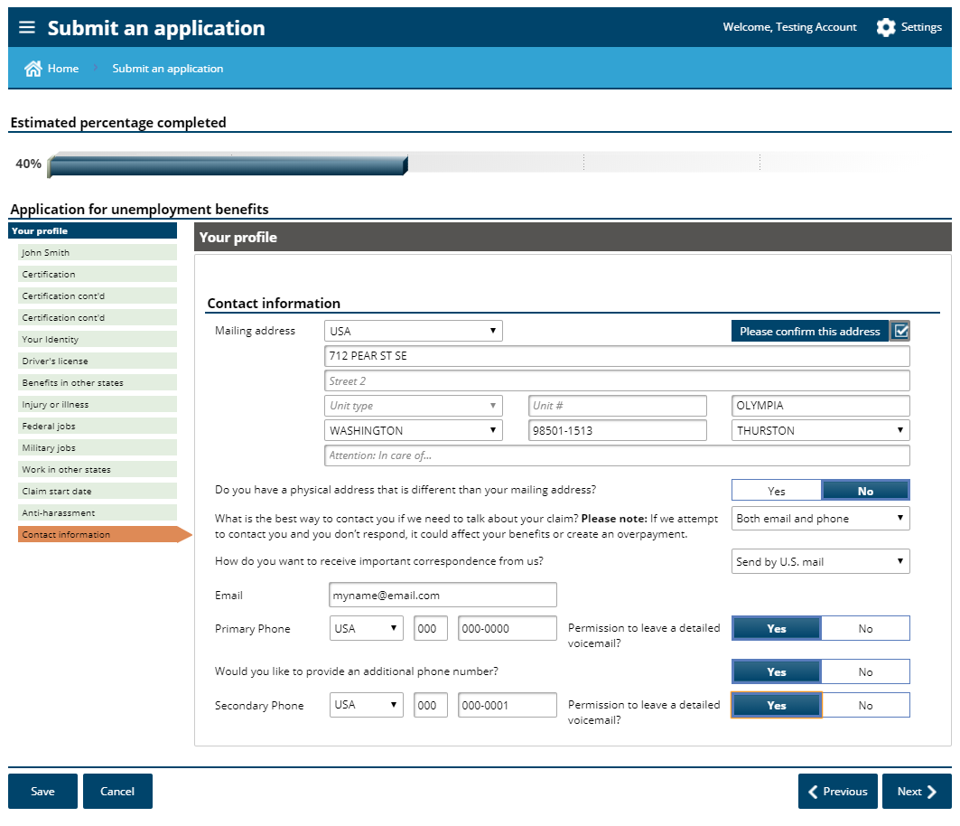

Slide 25
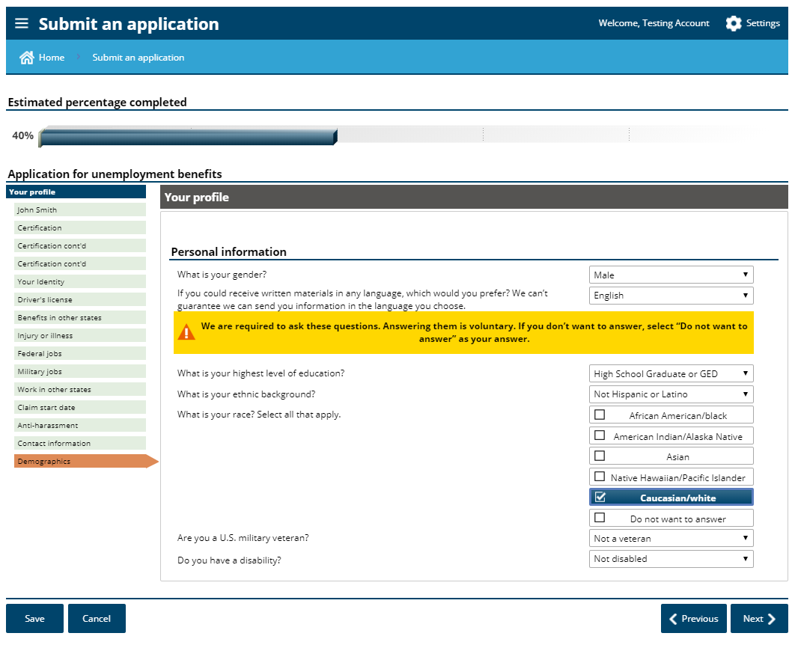

Slide 26
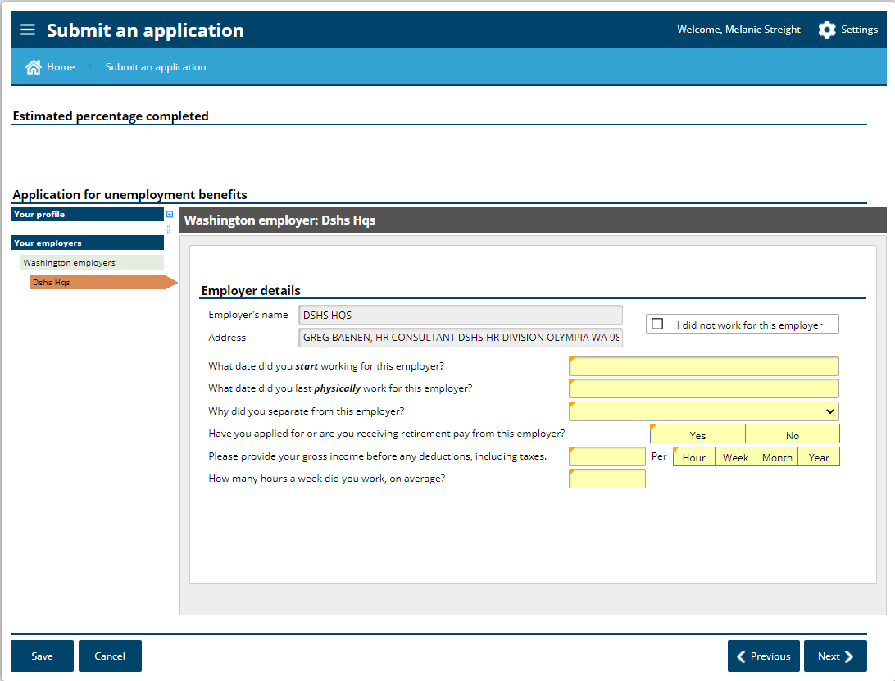
If you have wages reported from your State Agency, this will come up. If not, you will get the following screens.

Slide 27
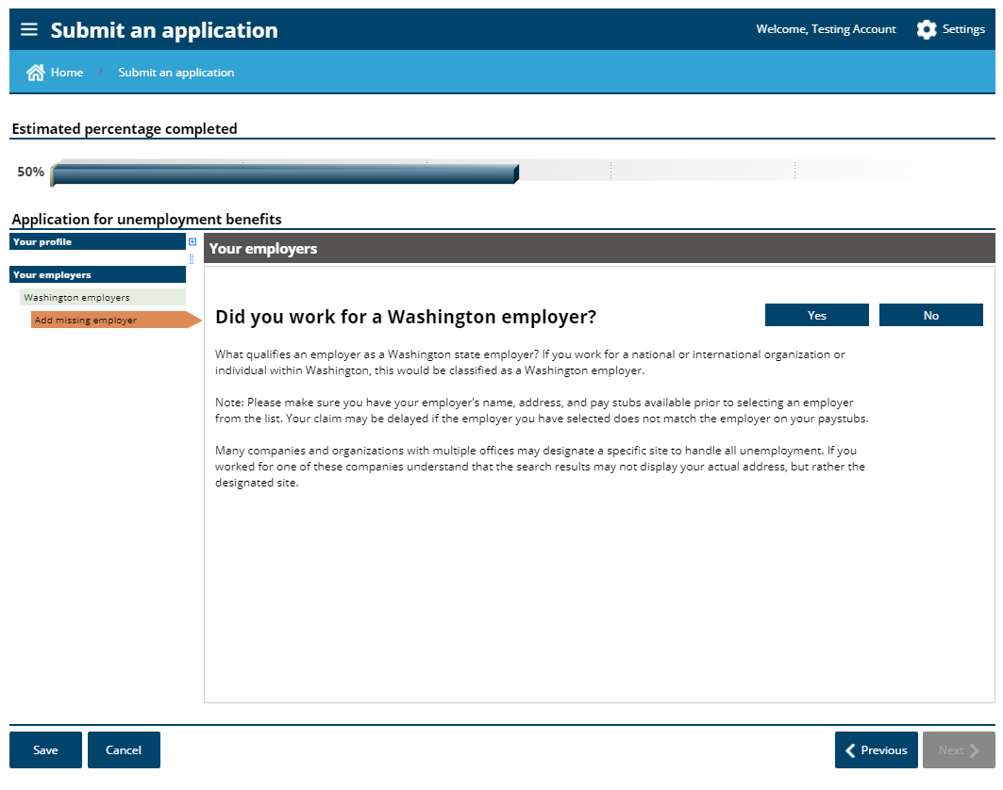

Slide 28
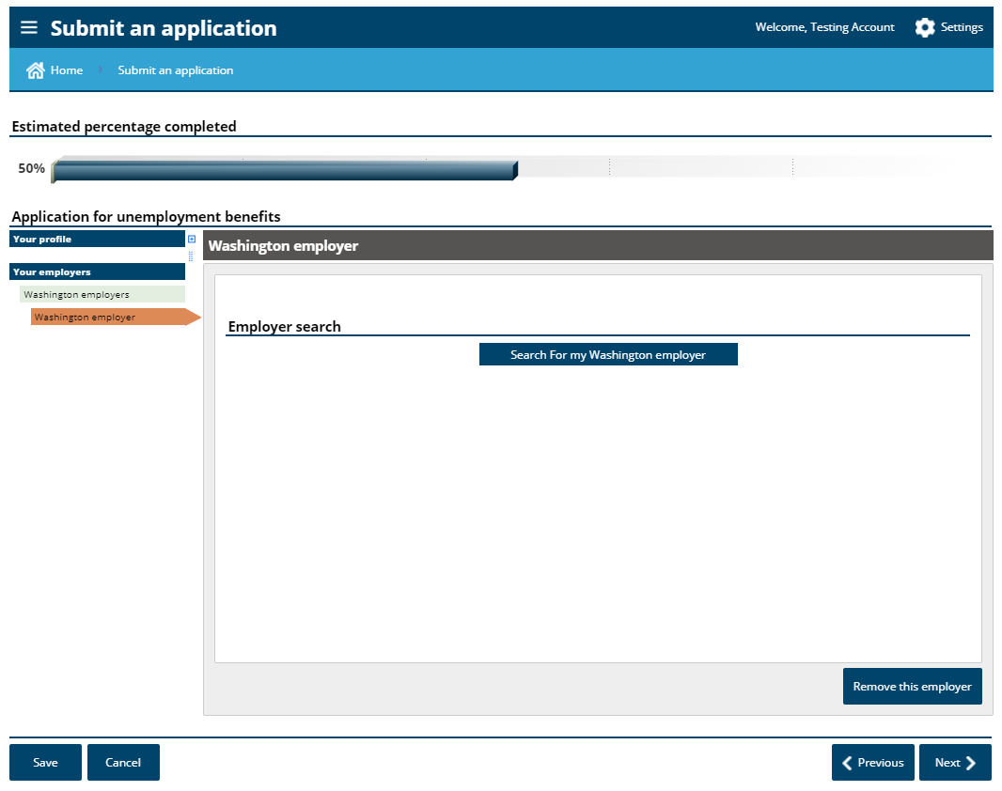

Slide 29
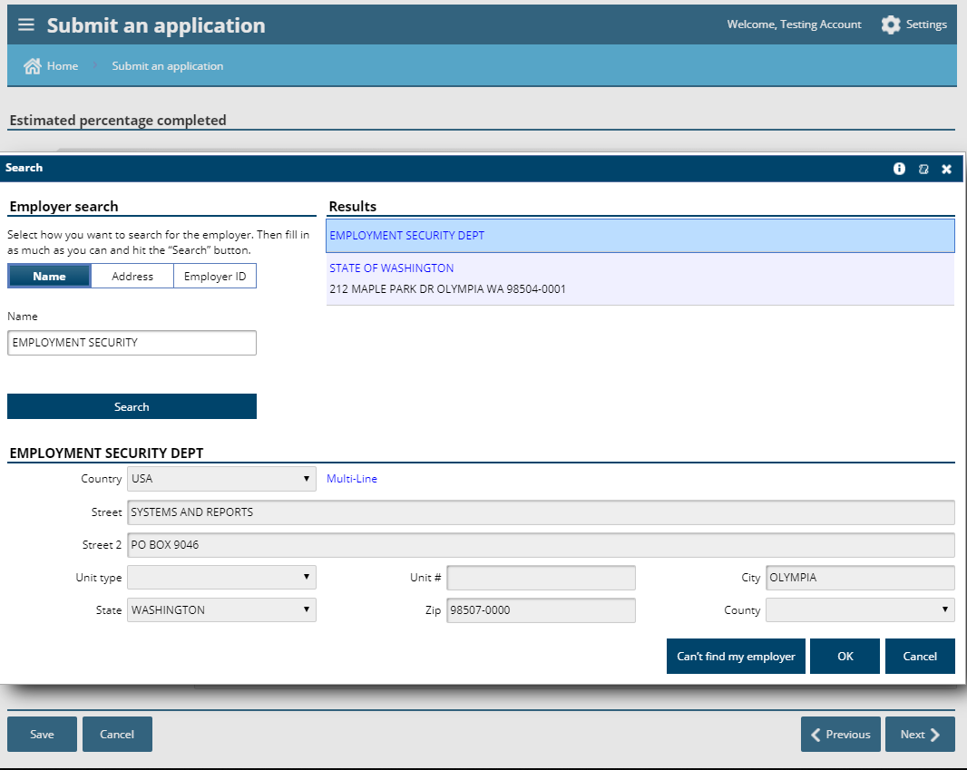

Slide 31
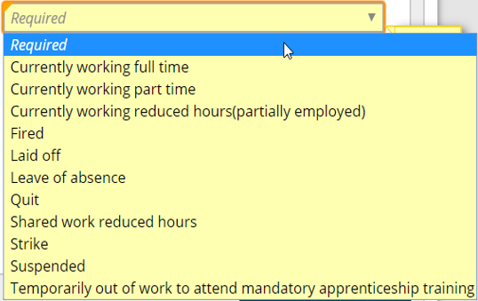

Slide 32
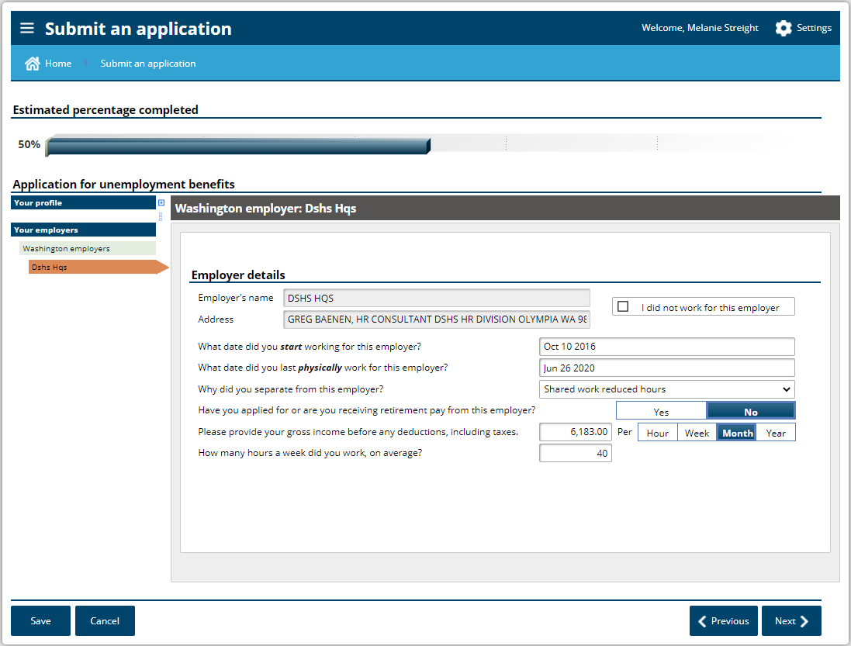
This is $ paid to you because you retired, not if you are contributing to your plan
Historical not, not furlough hours

Slide 33
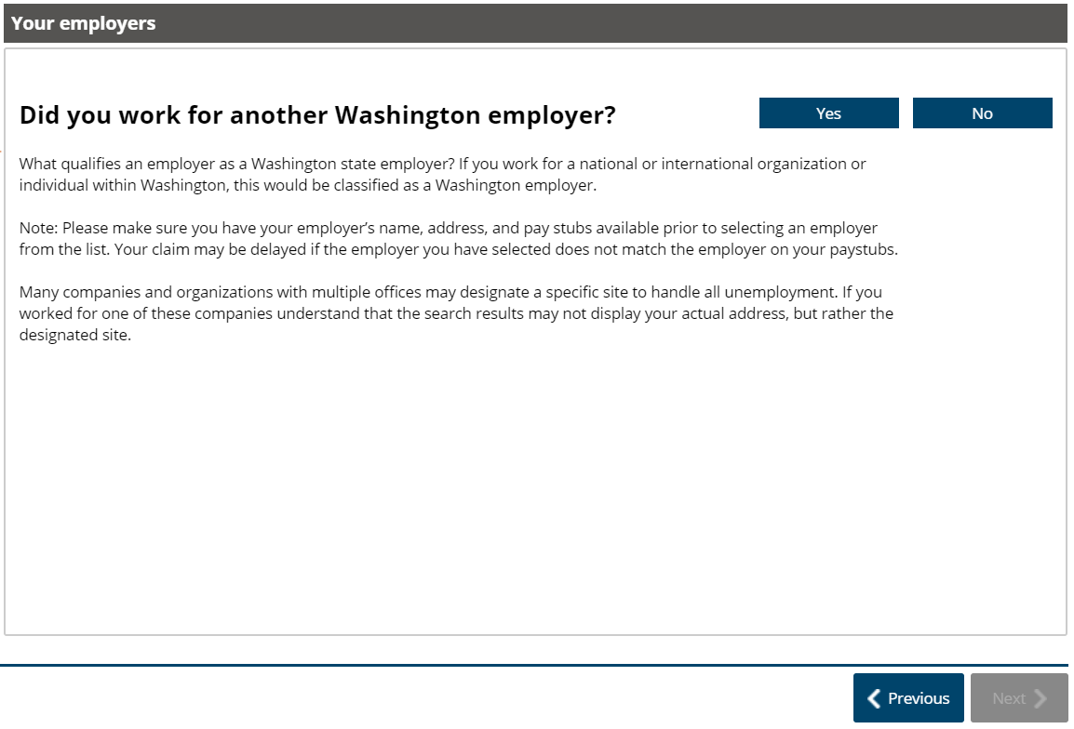

Slide 34
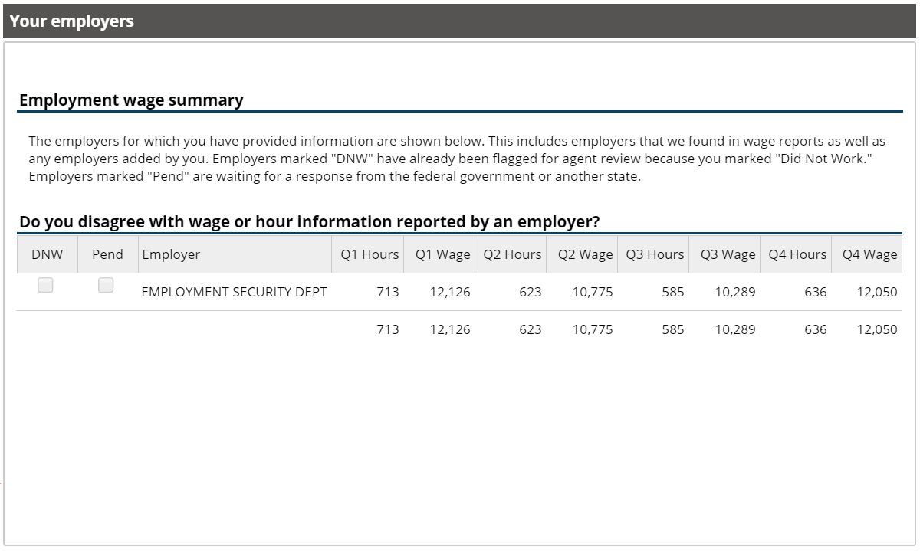
FYI Only. Please do not check either of these boxes.

Slide 35
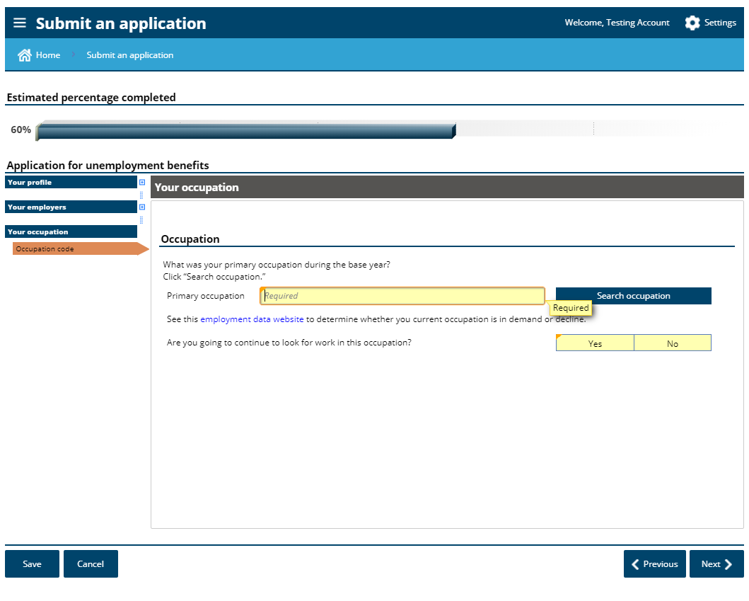

Slide 36
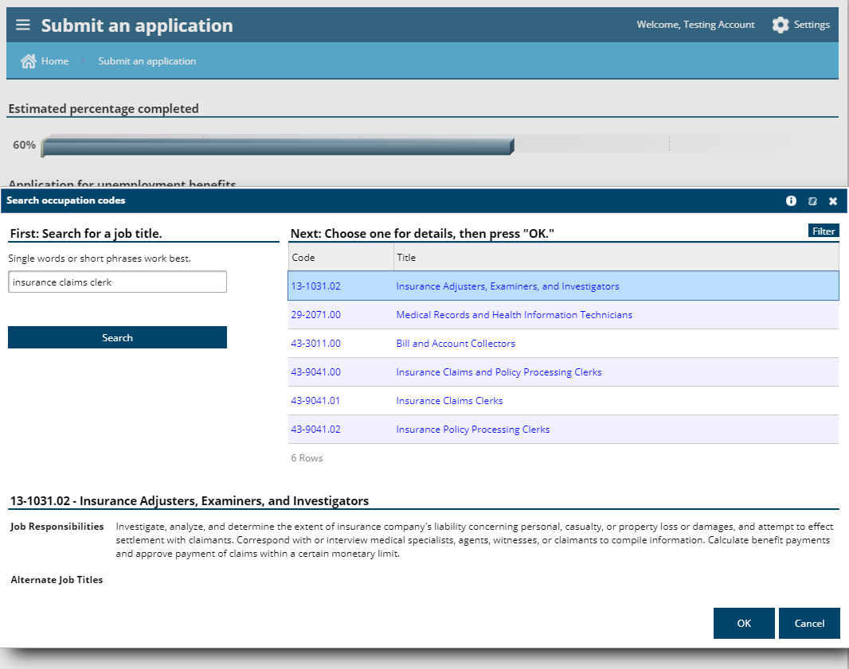

Slide 37
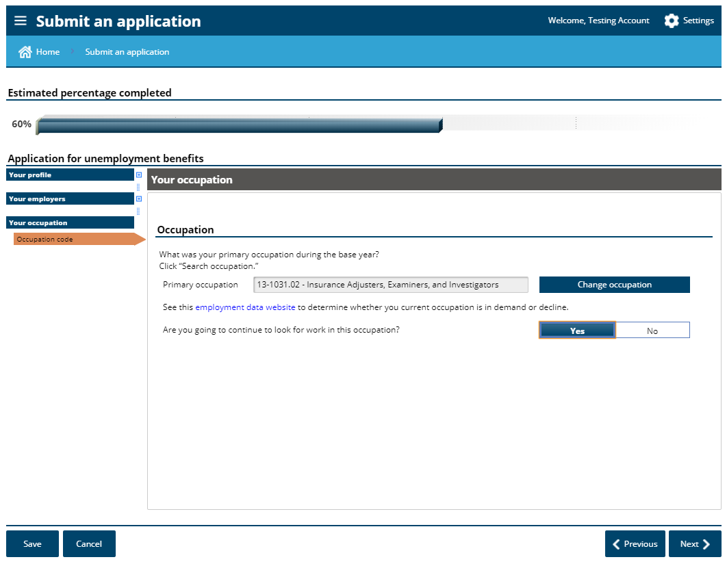
Answering “yes” to this question does not mean you are agreeing to go look for work. You are not required to do so while on SharedWork.

Slide 38
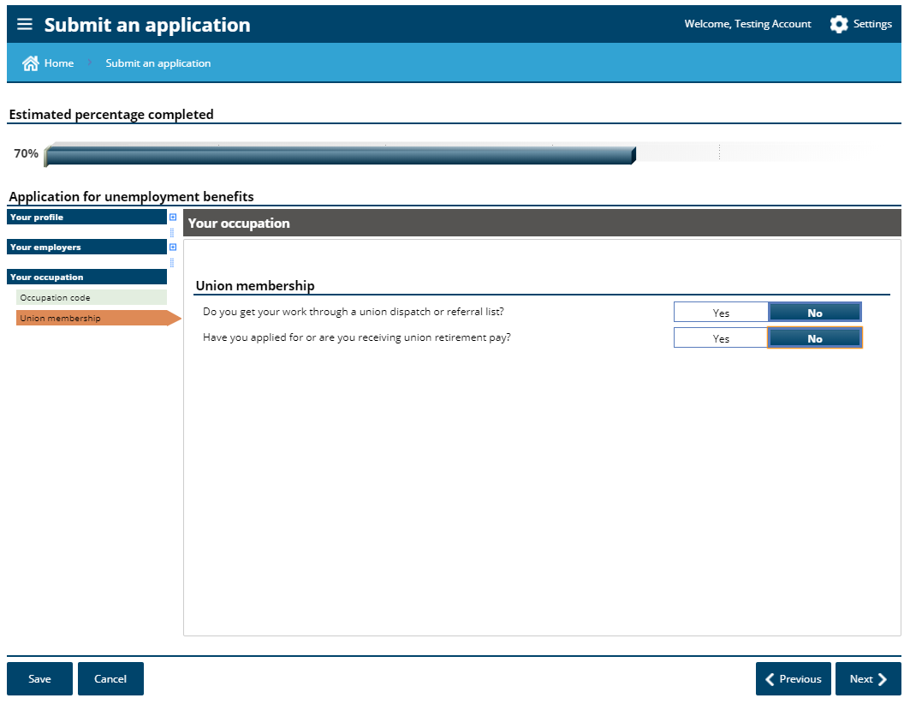
Unions in this capacity are those that you would find work through. State employees generally do not belong to this kind of unit.

Slide 39
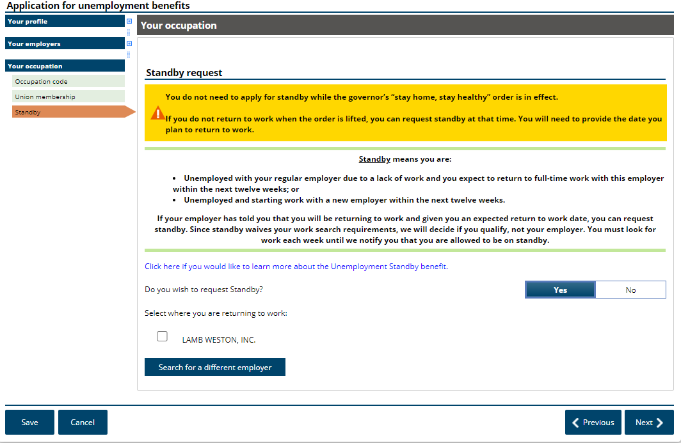
Requesting standby is not necessary while state employees are participating in the SharedWork unemployment program.

Slide 40
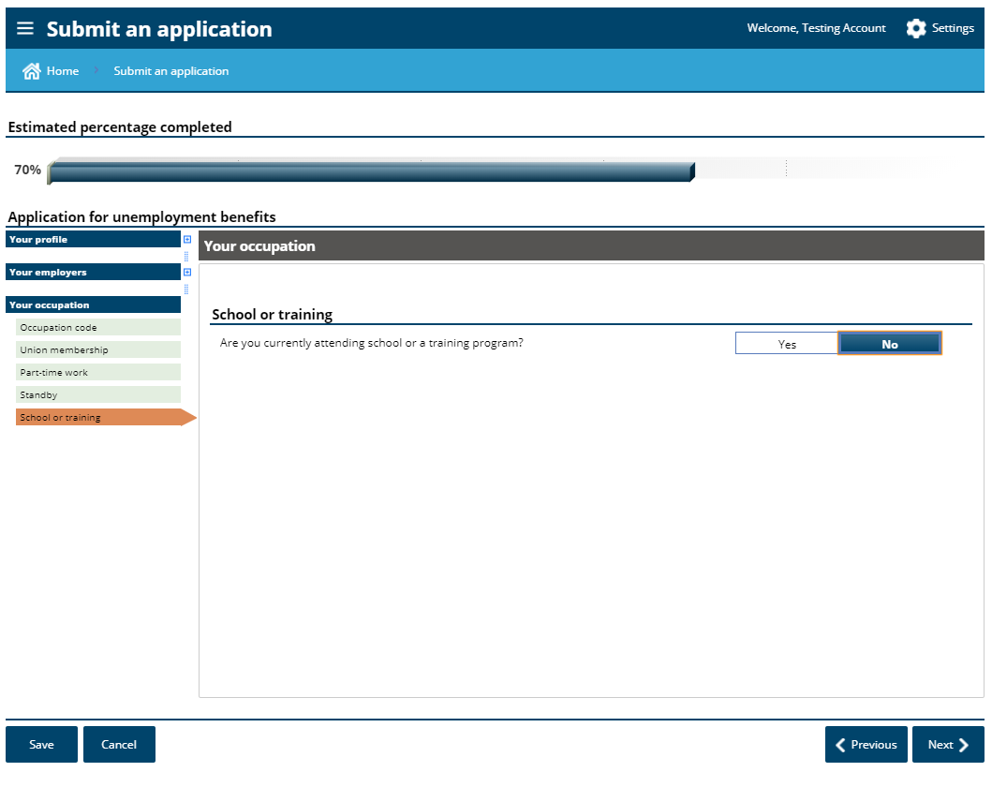

Slide 41
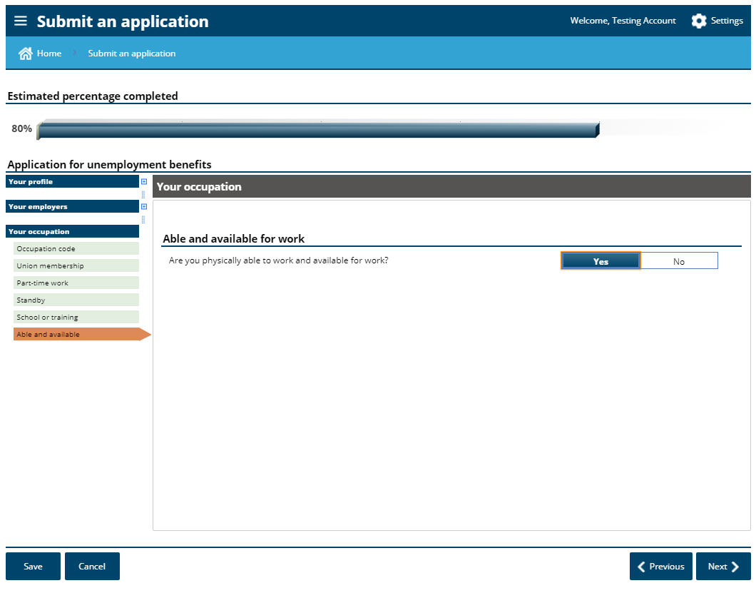
Be able to work all hours and be available for all work hours offered by the SharedWork employer.

Slide 42
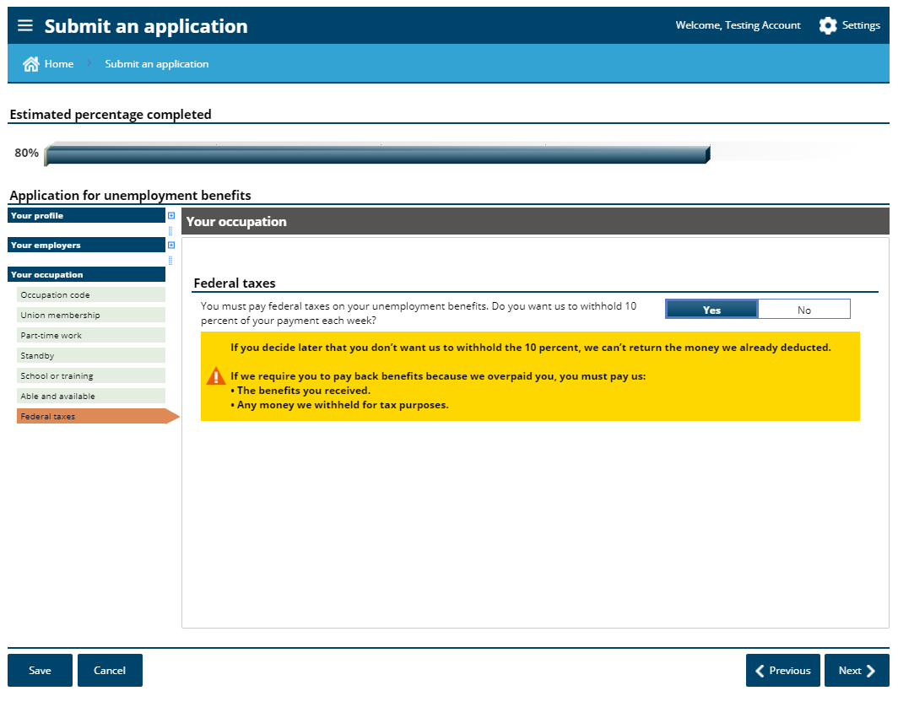

Slide 43
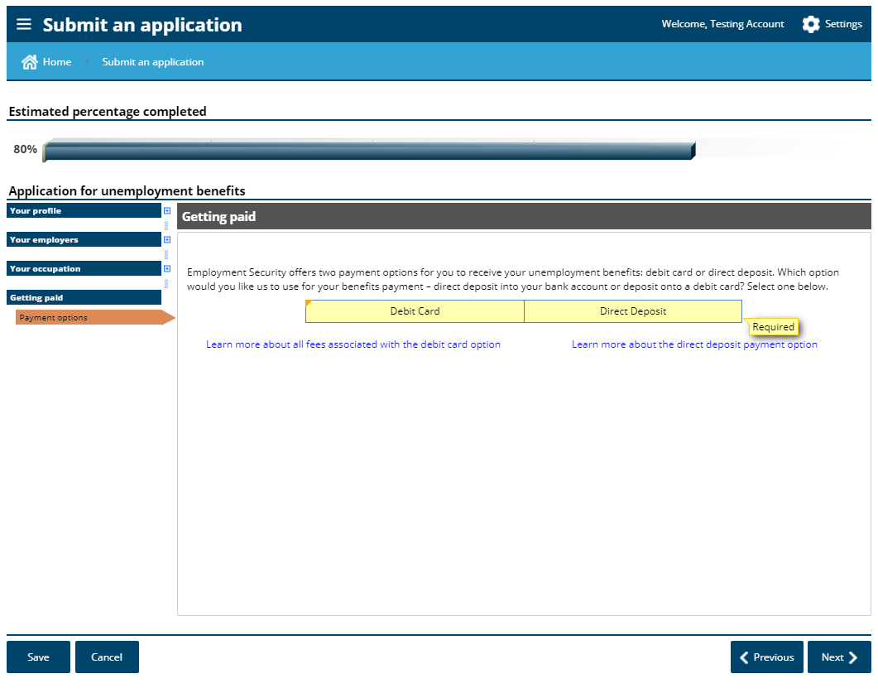

Slide 44
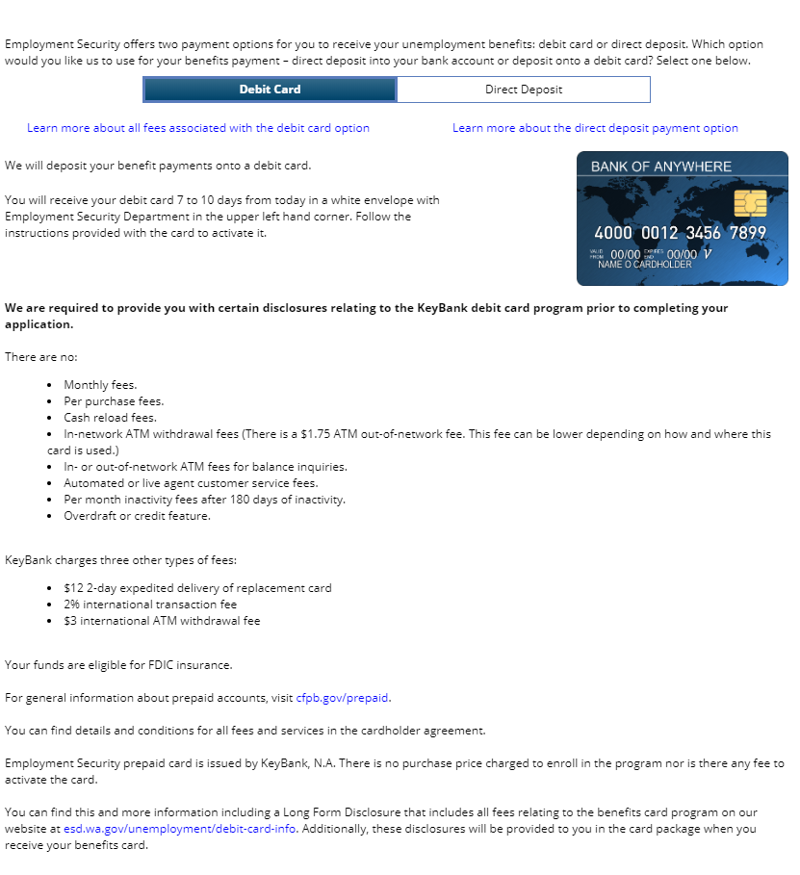

Slide 46
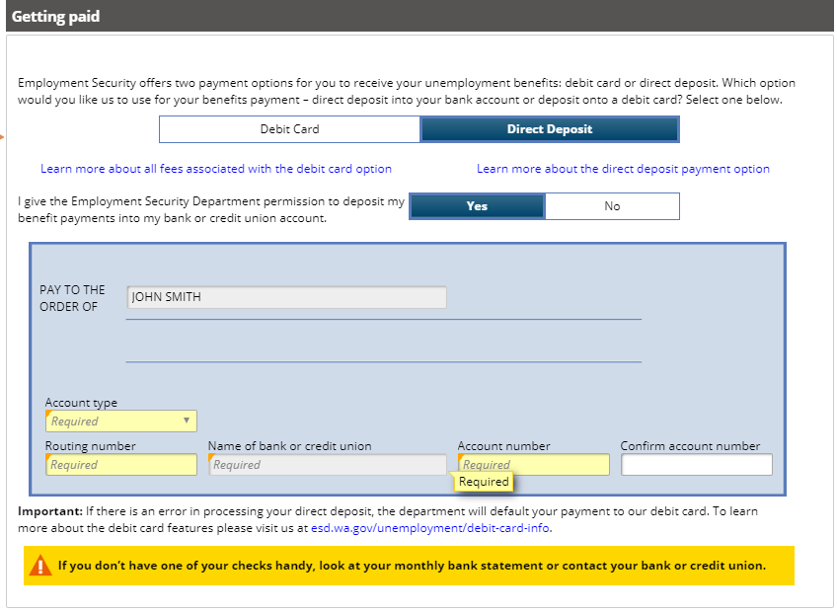

Slide 47
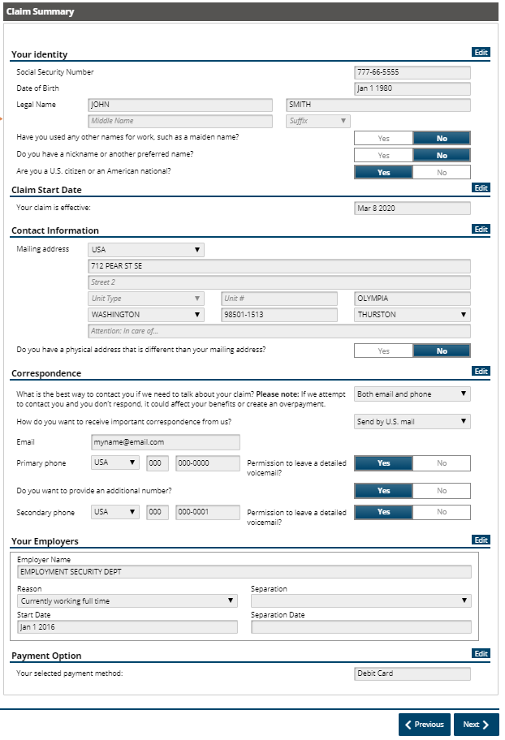
Each section has an “edit” button if you need to correct anything.

Slide 48
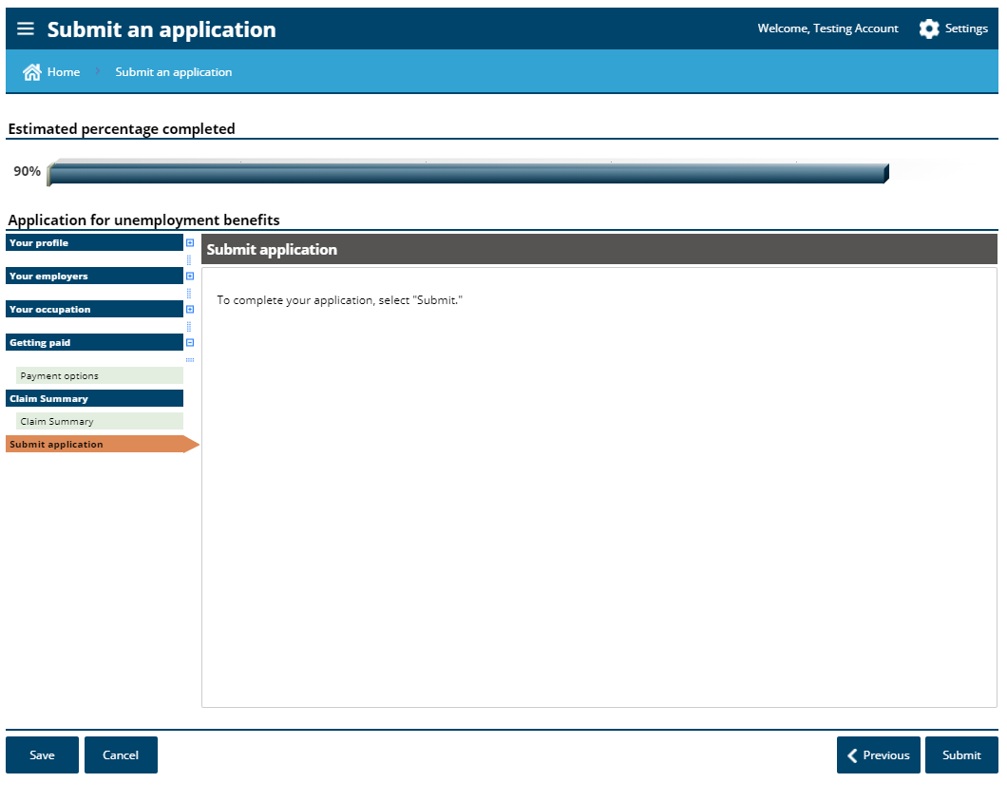

Slide 49
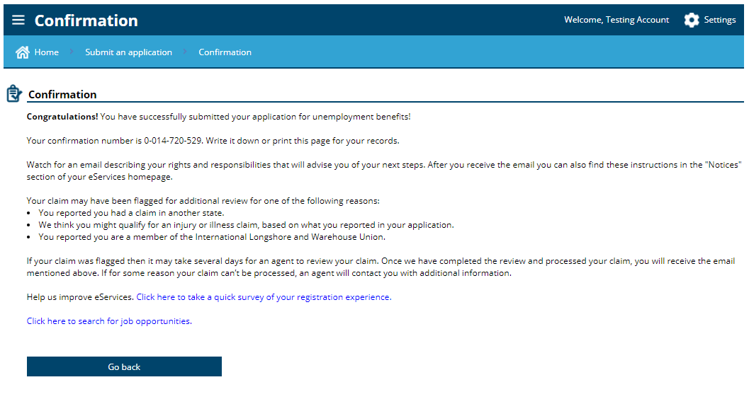

Slide 50
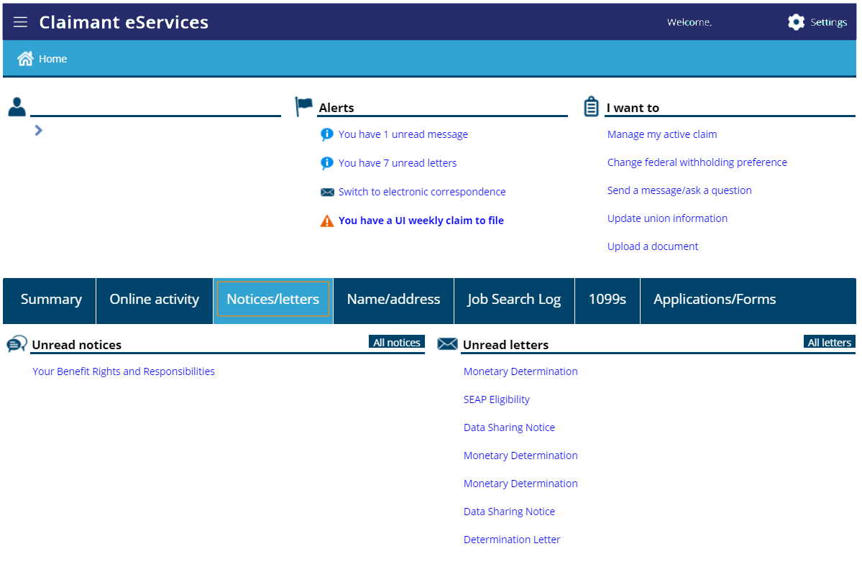

Slide 51
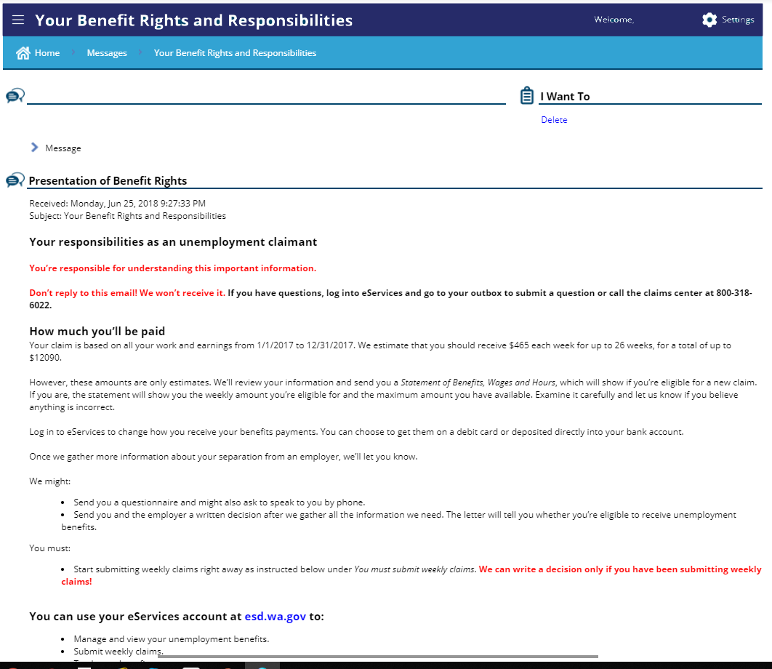

Slide 52
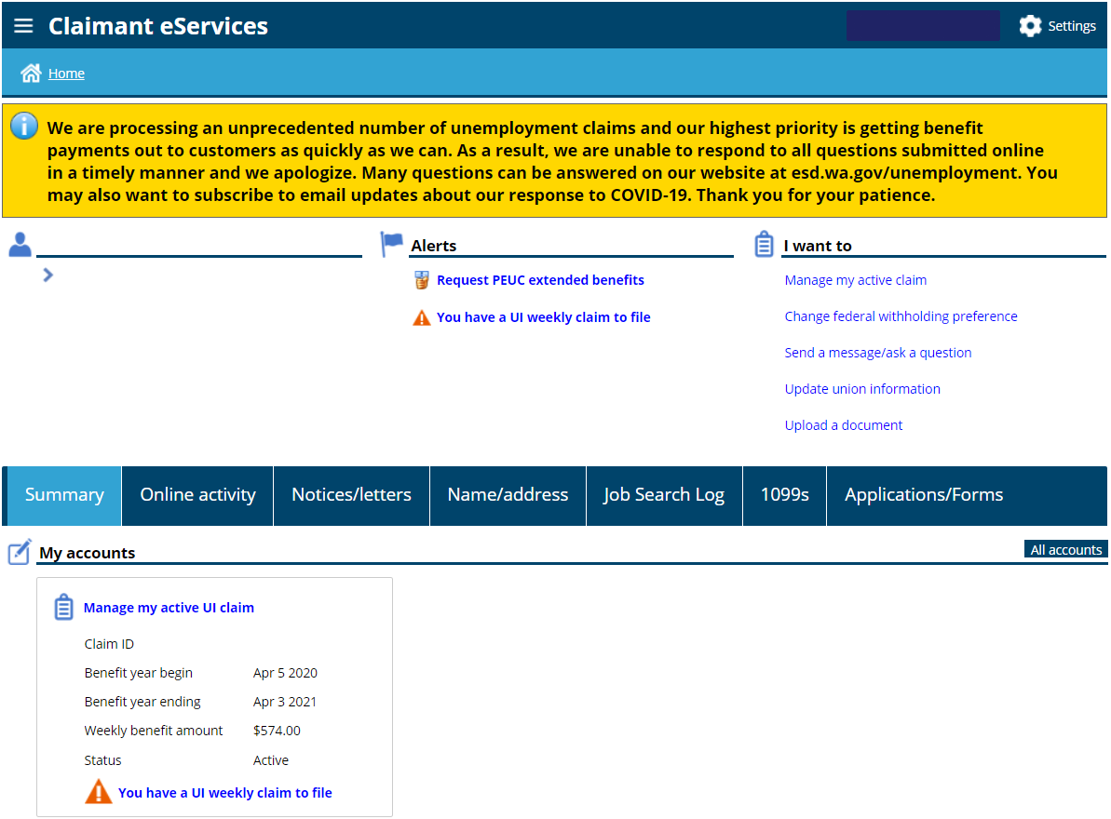
This will be how you access your current account

Slide 53
At this point, you have successfully filed a new claim. Next, we will cover just a couple more slides to keep you on the right path.

Slide 54
You can use either link to file your weekly claim.
It will appear every Sunday.

Slide 55
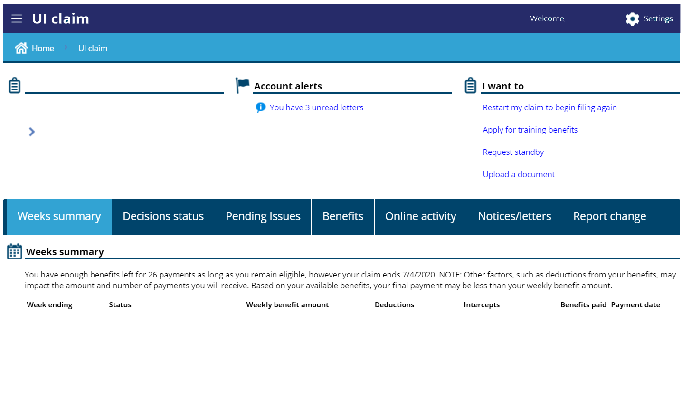
If needed later

Slide 56
What we know about the CARES Act
Pandemic Unemployment Assistance
This will expand benefits to those that are generally not covered by regular unemployment, such as self employed, independent contractors, worked less that 680 hours
An additional $600 added to benefits each week, Mar 29-Jul 25. There is no application process. This will be automatic if you qualify for any amount of regular unemployment.
Pandemic Emergency Unemployment Compensation
An additional 13 weeks for those that have exhausted their benefits
Follow www.esd.wa.gov for the latest information. You can even sign up to get alerts when new information is posted.
This Photo by Unknown Author is licensed under CC BY-SA

Slide 57
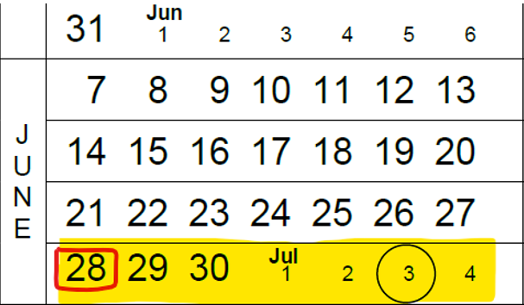
Lets talk about when your claim starts -
When is the start date of my claim?
A = If your first furlough day is during the week beginning 6/28, you can file your initial claim/application anytime during that week. If you start your claim during this week, you will not have a waiting week.

Slide 58
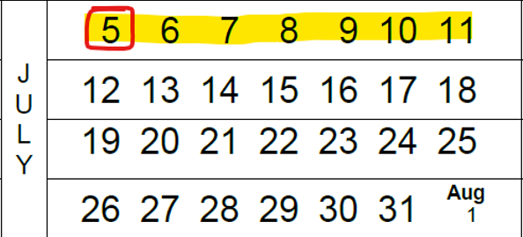
When do I file my weekly claim -
When do I file my weekly claims?
A = Preferably every Sunday for each previous week that you want to receive benefits. For example, if your claim start date is 6/28 you will submit your first weekly claim on 7/5 or anytime during that week.
Submit your weekly claim during this time
Start of claim

Slide 59
Unemployment Questions -
How do I file my weekly claim?
Using eServices, under the alert section, click on “You have a UI weekly claim to file”. You can also file by using our automated phone system 800-318-6022
What do I do when I return to work full time?
Just stop submitting your weekly claims
Is the waiting week being waived?
A = Yes, if your claim is effective between March 8th and July 4th, 2020. This is timeframe may be extended.

Slide 60
More Unemployment Questions -
Am I required to look for work?
A = Not as long as you are participating in the Shared Work program.
Can I receive unemployment if my employer is paying me sick pay, vacation pay, or personal time off?
A = Yes, but you have to report the hours and earnings if it is attributable to the week that you are claiming
I have a second job or I work part time at another job, can I receive unemployment?
A = Yes, it is possible. You will need to report your hours and earnings during the week that you are doing the work.

Slide 61
More Unemployment Questions -
What is the base year?
A = Currently it is January 2019 through December 2019
Note: On July 1, the base year will change to April, 2019 through March, 2020
I have a link to apply for PUA or PEUC. Do I need to do that?
A = No, not at this time. You will only apply for PUA only if you do not qualify for regular unemployment. PEUC – is for those that have used all the unemployment money in their account and need additional weeks to claim. You apply for that when you are nearing the end or have exhausted all the benefits in your regular claim.
What do I do if my name and social security number has been used for a fraudulent claim?
A = Report this to ESD asap by using the “Report imposter fraud” link on our esd.wa.gov website.
All information and Frequently Asked Questions on www.esd.wa.gov

Slide 62
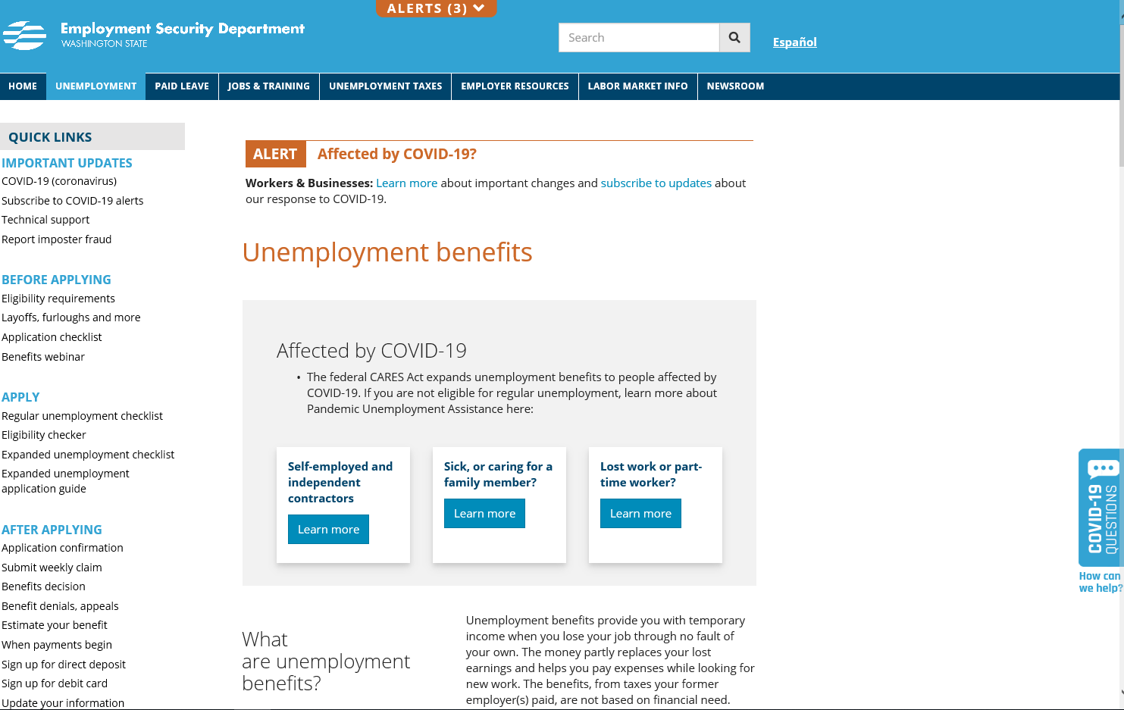
Scroll down for additional links and information

Slide 63
Resources to Help!
For everything – www.esd.wa.gov
This includes COVID-19, as it relates to programs and services provided by the Employment Security Department
SharedWork Site – esd.wa.gov/SharedWork
eServices Account Support – 855-682-0785
Unemployment Insurance Claims – 800-318-6022
Shared Work Unit – 800-752-2500
Your Agency’s Shared Work Representative
Reemployment and Retraining Services –
www.WorkSourceWA.com

