Slide 1

Yakima Valley Agriculture:
Growth Opportunities and Constraints

Slide 2
Enhancing the value of all segments of the tree fruit industry.
Education and Training
Industry Data
State Issues
Advocacy

Slide 3
Agriculture in Washington
$10.6 billion in production in 2016.
2016 top crops:
  Apples $2.39 billion (22% of state’s ag value)
  Milk $1.1 billion
  Potatoes $813 million
  Cattle $704 million
  Wheat $657 million

Slide 4
Top Crops (Cont.)
  6. Cherries $503 million
  Hay $479 million
  Hops $382 million
  Grapes $360 million
  Pears $233 million
  All together, tree fruit is more than 29% of WA ag value at the farm gate.

Slide 5
The Big Apple
$3.4 billion in value after packing
  $254.4 million in state and local taxes
$7.5 billion in total economic impact
39,340 direct jobs (orchard to packing)
21,870 indirect jobs (transportation, suppliers)
$955 million in direct employee compensation
$1 billion in indirect employee compensation

Slide 6
Employment
Yakima County had 111,531 jobs in 2016
31,360 of those were in agriculture (28%)
64% of the 12,625 jobs added in Yakima County from 2004-2016 were in Agriculture
Only 21.8% of total wages, why?
  Seasonal Employment
  Support functions are separate firms
    Trucking and freight brokerage
    Sales and marketing
    Supplies
  Still, ag wages grew at more than double the overall rate during that period. (157% versus 64% overall)

Slide 7
This is the Place
Yakima County is #12 highest US County for Ag production value, and #1 for apples.
More than 60% of U.S. Apples produced in Washington State.
Over 30% of our fruit crops are exported overseas, where our quality is in high demand.
Even to apple producing nations like China, which is number one at 8 times U.S. production.

Slide 8
Organics
93% of US Organic apples are grown in WA
79% of US Organic pears are grown in WA
94% of US Organic cherries are grown in WA
Tree Fruit is more than 60% of WA organic farmgate value and 23% of organic acreage
Organic yields per acre are increasing as higher densities planted to organic, more acres being planted as well
11% of apple acreage is organic, about 7% of fresh sales

Slide 9
WA Farms with Apple Production
1910 – 27,150 farms
1920 – 35,535 farms
1935 – 44,293 farms
1954 – 10,318 farms
1964 – 6,364 farms
1987 – 5,169 farms
2007 – 3,052 farms
2012 – 2,839 farms

Slide 10
WA Apple Production: Spot the Trend
1919
21,568,691
2001 84,815,000
2014 141,849,000
1986 60,000,000
Measured in 40# box equivalents

Slide 11
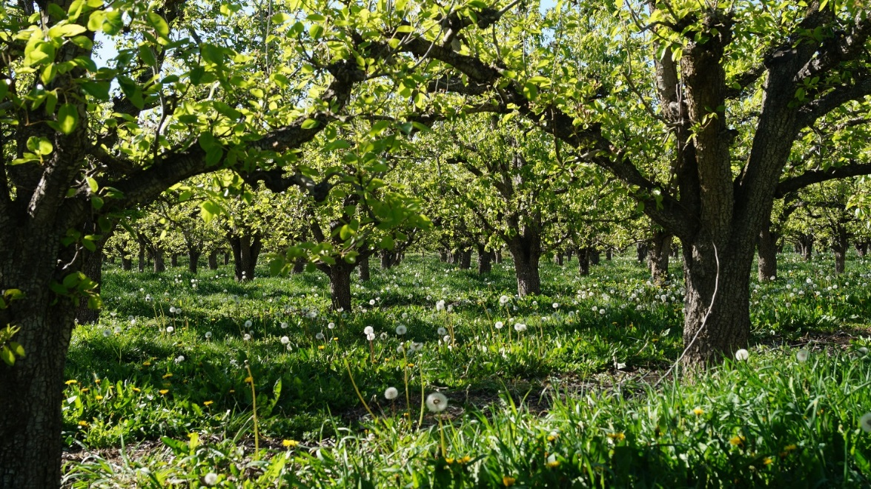
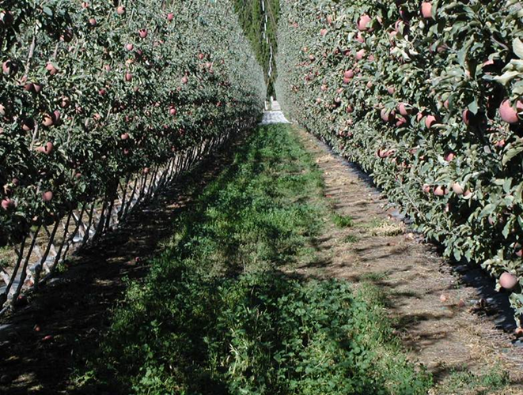
Larger Production, Smaller Trees
Stable WA Apple Acreage:
172,000 acres in 1993
179,000 acres in 2017
4.1% increase in acreage
Growth of Apple Production
in the same period:
83,088,000 boxes in 1993
134,471,000 boxes in 2017
An increase of 62%.

Slide 12
Policy and Economic Challenges Drive Consolidation
Calibration of Market Signals
Complexity
  Increasingly precise pest management.
  Food Safety: perfection and program management.
Competition
  Customer consolidation.
  Investment in new varieties.
  Trade and access to customers.
Constraints on Inputs
  Labor supply and cost vary according to both market and political forces.
  Water

Slide 13
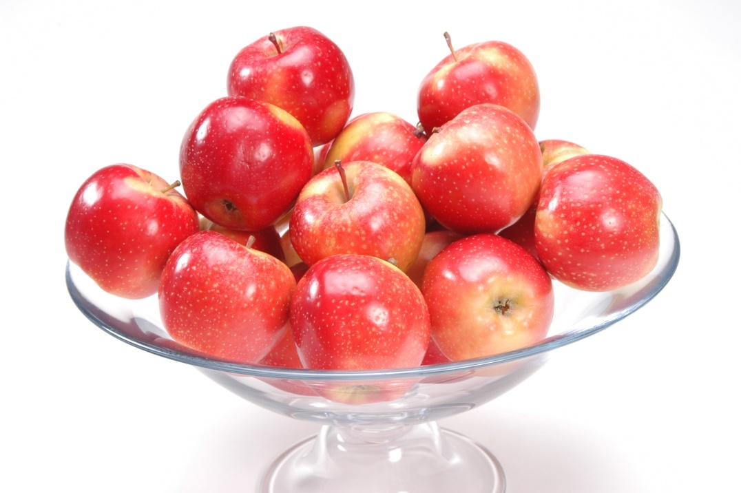
Varietal Development
Apple Varieties in 1999:
51% Red Delicious
17% Golden Delicious
10% Fuji
8% Gala
8% Granny Smith
6% Other Varieties
2016 Crop:
29% Red Delicious
23% Gala
11% Granny Smith
13% Fuji
5% Golden Delicious
6% Honeycrisp
13% Other Varieties

Slide 14
New Varieties
Where do they come from?
  Random discoveries
  Breeding programs
Patented material and trademarked names
  Cost to buy in
  Bet the farm on the right one
Establishment costs of $50,000 per acre
  $1 million for a 20 acre orchard
  3-5 years until full production

Slide 15
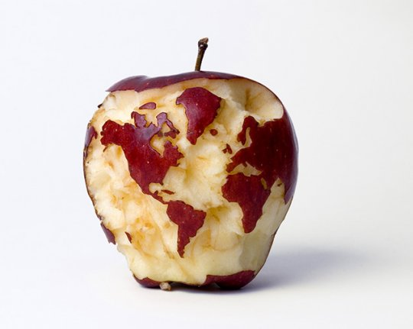
2016-17 Apple Export Markets
* In standard 40 pound boxes
Mexico 13,730,201
Canada 5,696,209
India 4,932,463
Taiwan 3,053,796
China 1,798,874
Indonesia 1,541,939
Dubai 1,375,863
Vietnam 1,344,462
Saudi Arabia 1,038,179
Hong Kong 1,012,310
Total: 41.75 million
Europe: 66,755

Slide 16
Value of NAFTA
Mexico and Canada are number 1 and number 2 export markets for apples and pears.
  $97 million in annual pear exports from WA
  $345 million in annual apple exports from WA
  $105 million in cherry exports from WA
Exports have increased 70% since NAFTA was passed.
Ensures rules-based resolution of trade disputes.

Slide 17
Transport Costs
Access to sea transport to Asia is a key advantage.
Transport cost from Yakima or Wenatchee to the Ports of Seattle or Tacoma is $1,200 per truckload (container).
Transport cost from the Puget Sound ports to Shanghai is $2,600-$2,900.
Transport cost from Central Washington to the East Coast of the United States is $8,000-$10,000 per truckload.

Slide 18
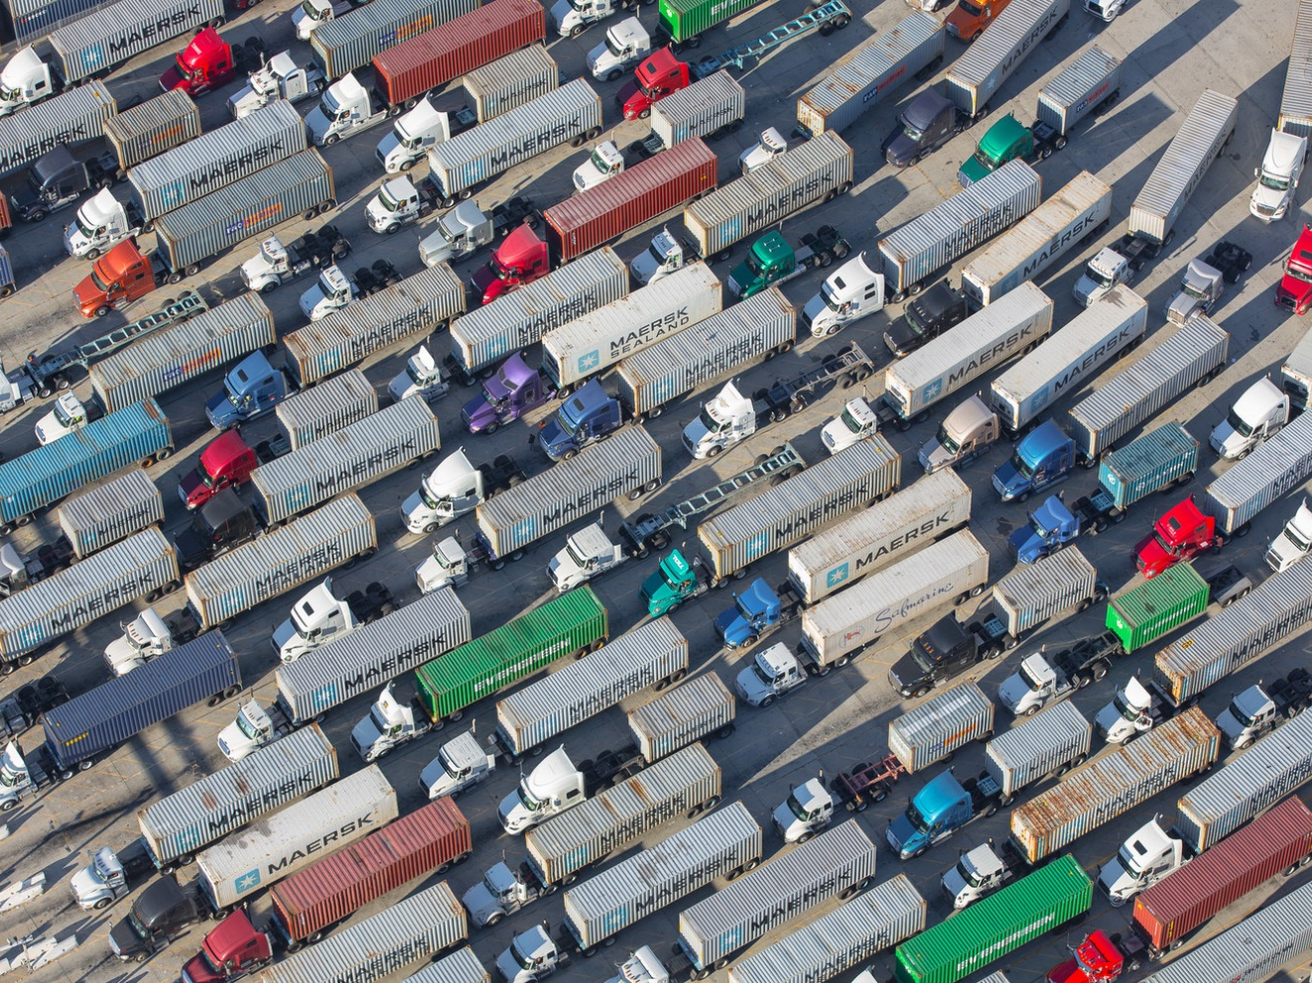
Market Disruptions
The 2014-15 port slowdowns began just as apple harvest completed and when peak Asian exports usually take place.

Slide 19
Disparate Price Impacts
2014-15 Average FOB
  Red Delicious $14.10 per box
  Honeycrisp $54.93 per box
  Average packing charges $10-$11 per box
Older varieties like Red Delicious are particularly dependent on the export market.
Consumer segmentation.

Slide 20
Labor and Legal Status
~160,000 total agricultural workers in WA
90,000 seasonal at July peak (cherries)
H2-A visa program in WA
  814 workers in 2006
  18,500 in 2017
  Housing and transportation plus higher wage
  $14.12 minimum in WA in 2018
    With piece rates, often much higher income
  No guarantees that USDOL will meet deadlines

Slide 21
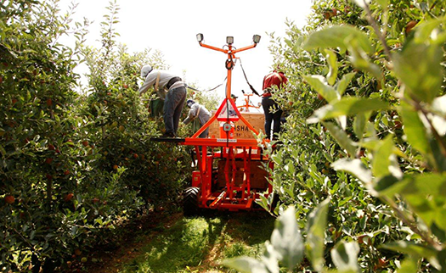
Labor Assistance
Harvest equipment such as platforms, conveyors.
Increases worker productivity, less physically demanding.
Photo: Domex Superfresh

Slide 22
Conclusions
Washington agriculture is poised for continued growth and global competitiveness.
Policy decisions and market forces will continue to force growers to replace existing inputs with new capital investments.
Smaller growers will find this uncertain environment most challenging.
The long-term trend toward consolidation paired with growth is likely to continue.

Slide 23
Jon DeVaney, President
jon@wstfa.org
105 S. 18th Street, Suite 116
Yakima, WA 98901
509-452-8555

